Slide 1




Build Ontology View on ArchiMate 3.2 Specification
001
Opening

Slide 2

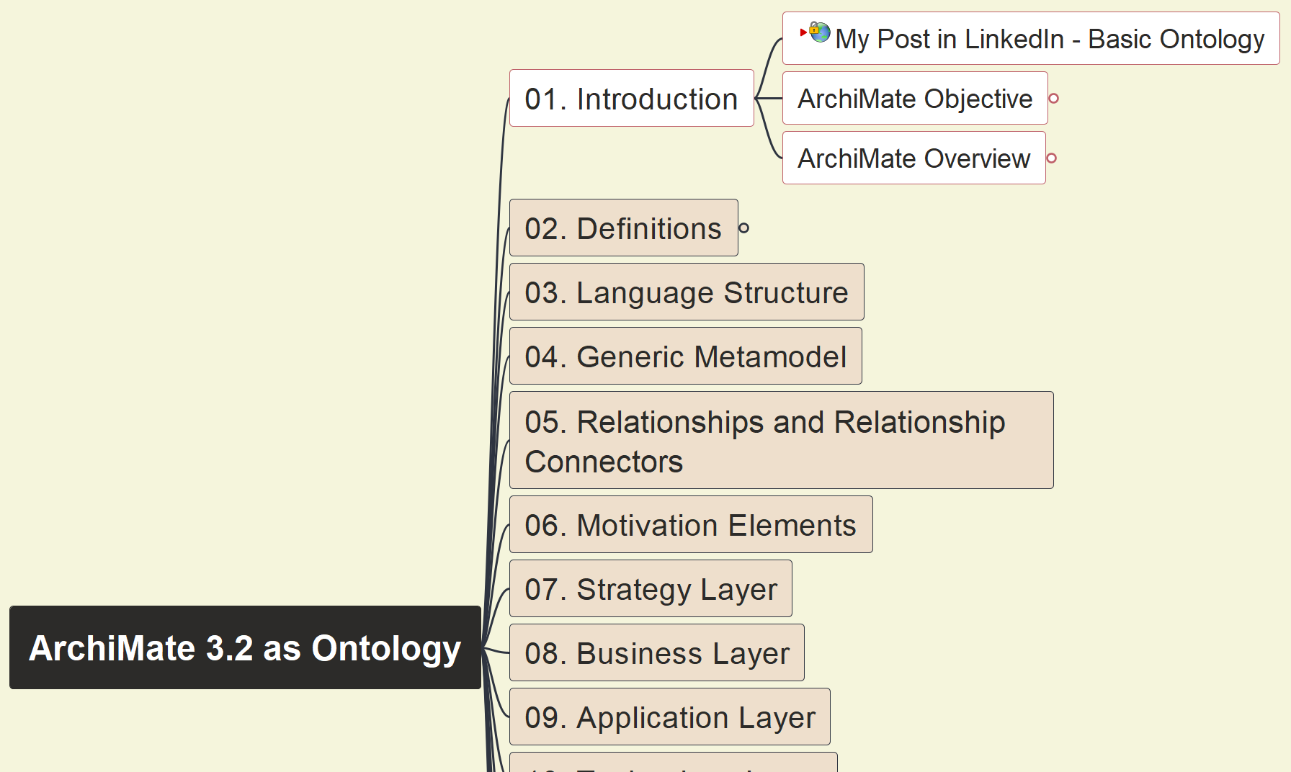
Build Ontology View on ArchiMate 3.2
002
ArchiMate Language Objective

Slide 3
Build Ontology View on ArchiMate 3.2
003
ArchiMate Language Overview

Slide 4
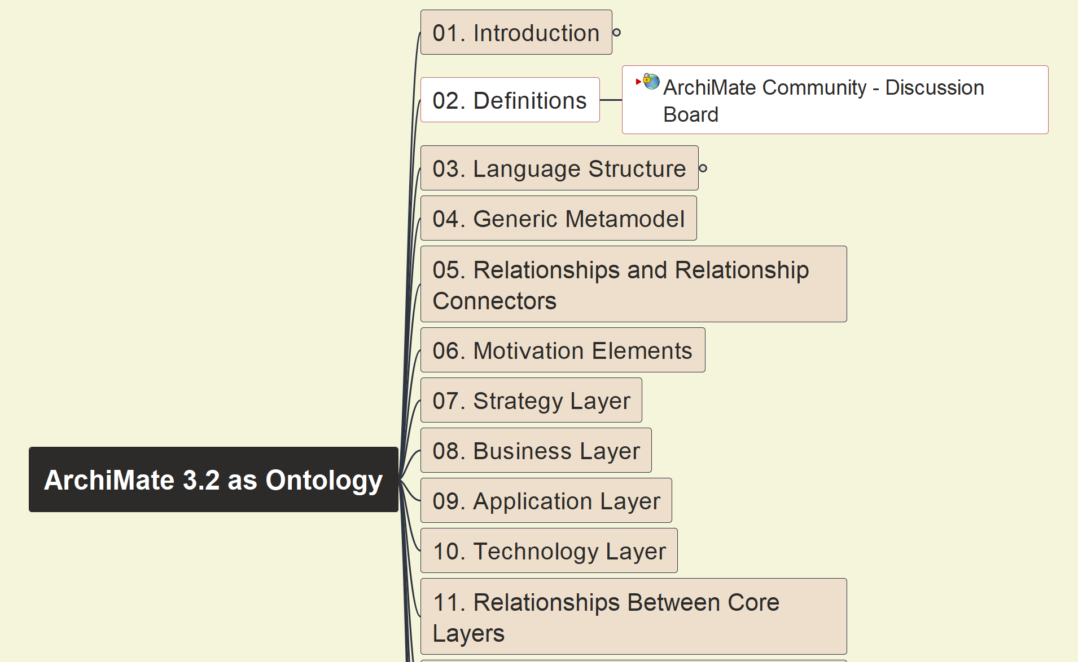
Build Ontology View on ArchiMate 3.2
004
ArchiMate Definition

Slide 5
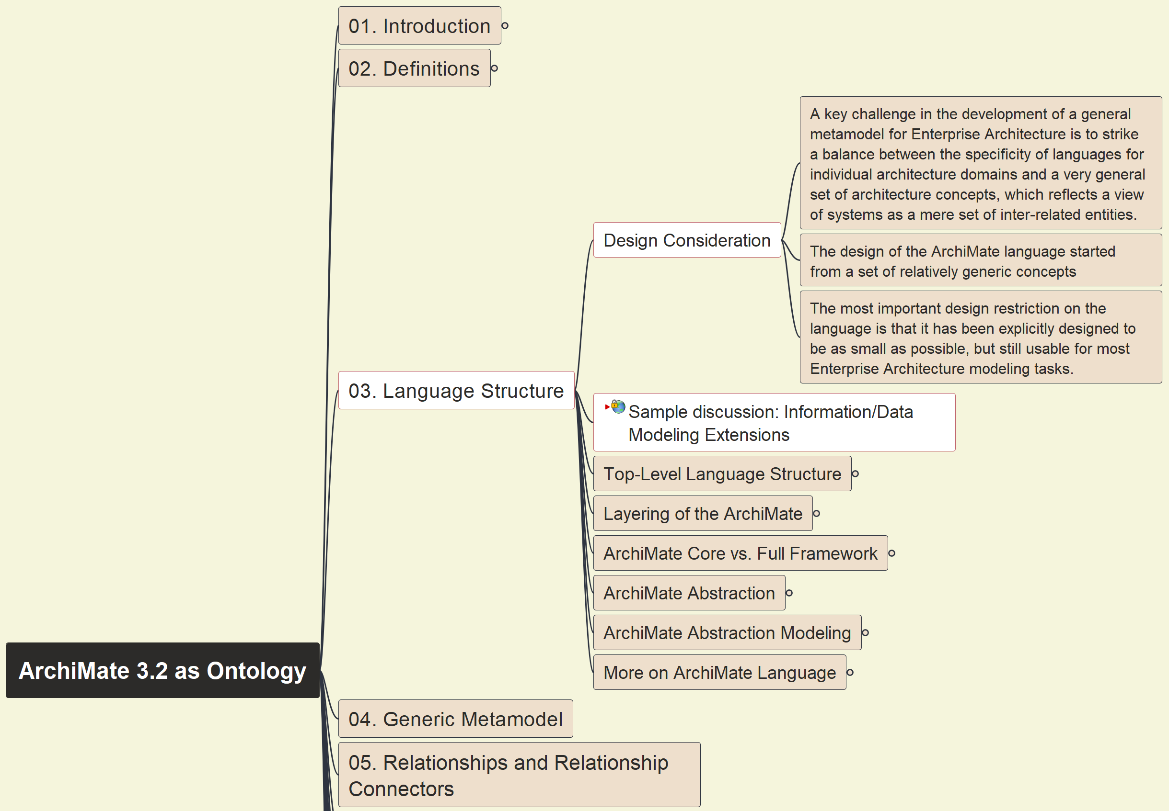
Build Ontology View on ArchiMate 3.2
005
ArchiMate Structure – Design Consideration

Slide 6
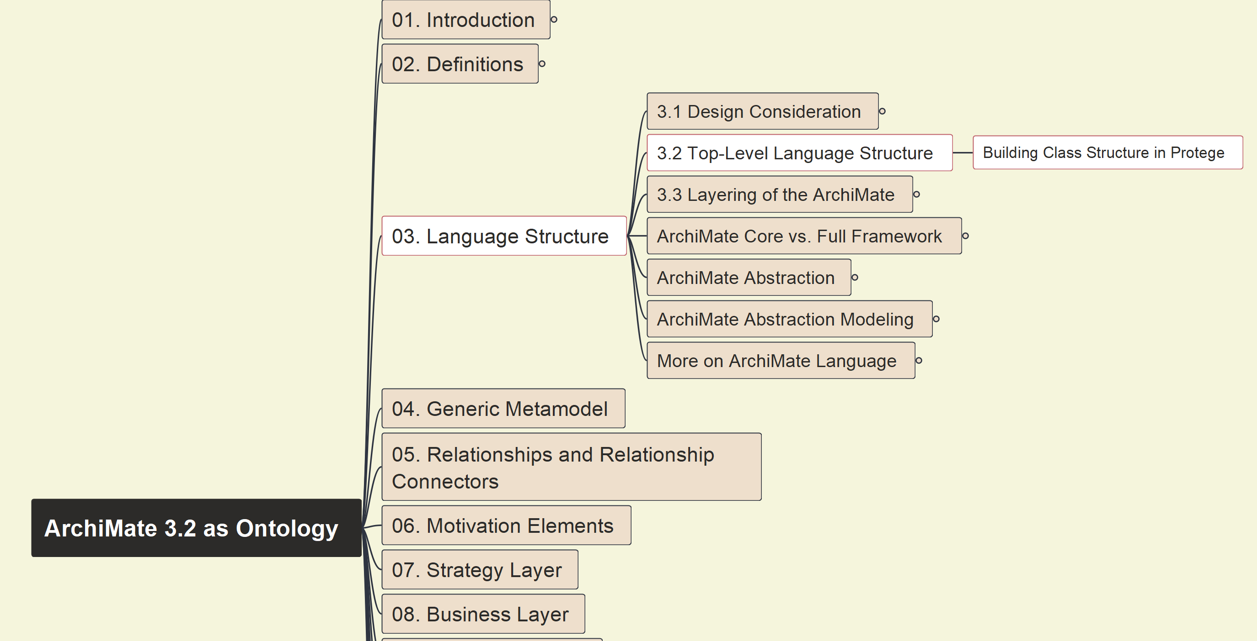
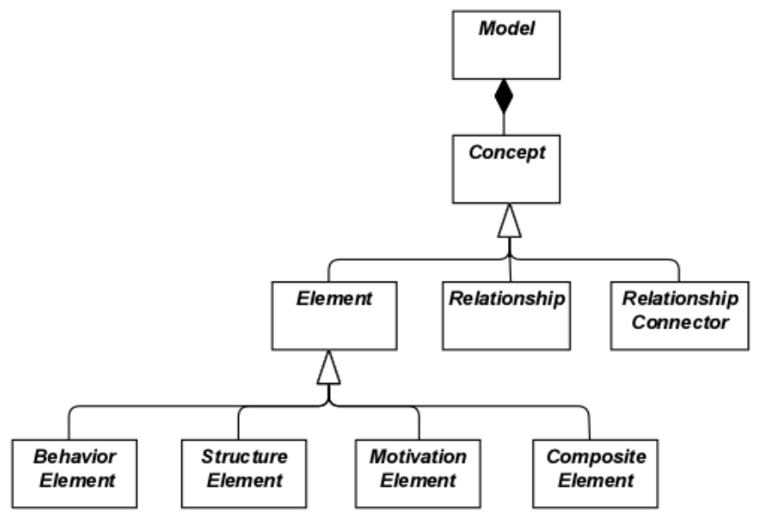
Build Ontology View on ArchiMate 3.2
006
ArchiMate Top-Level Structure

Slide 7
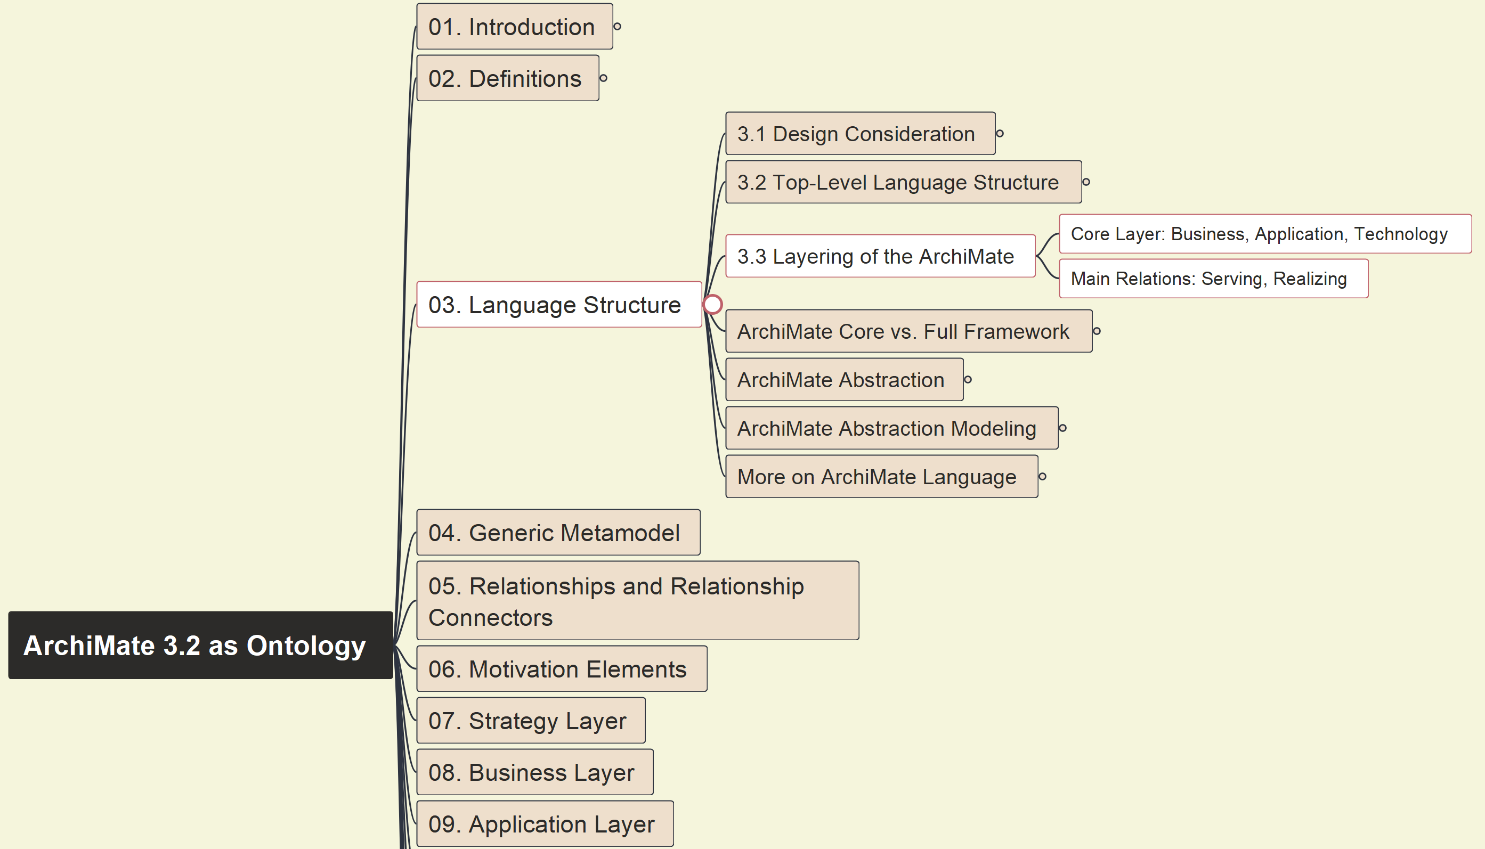
Build Ontology View on ArchiMate 3.2
007
ArchiMate Layering

Slide 8
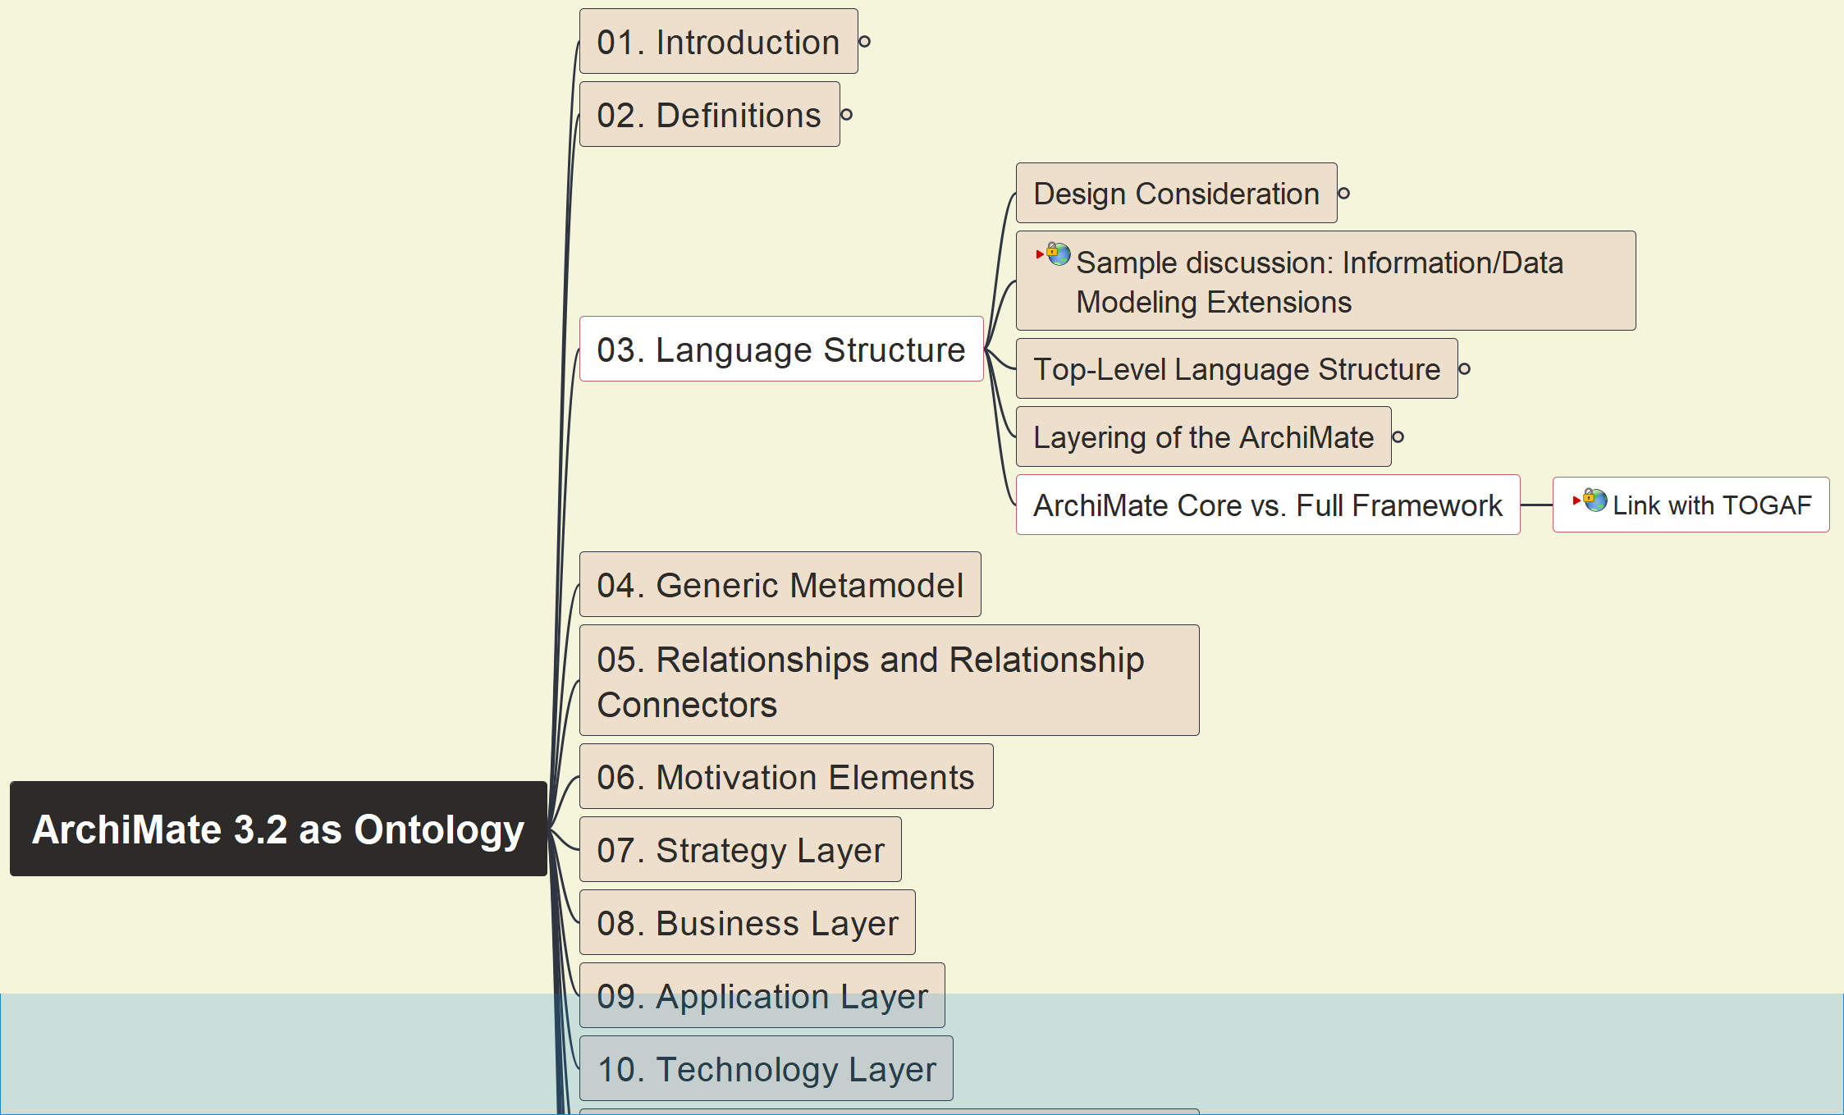
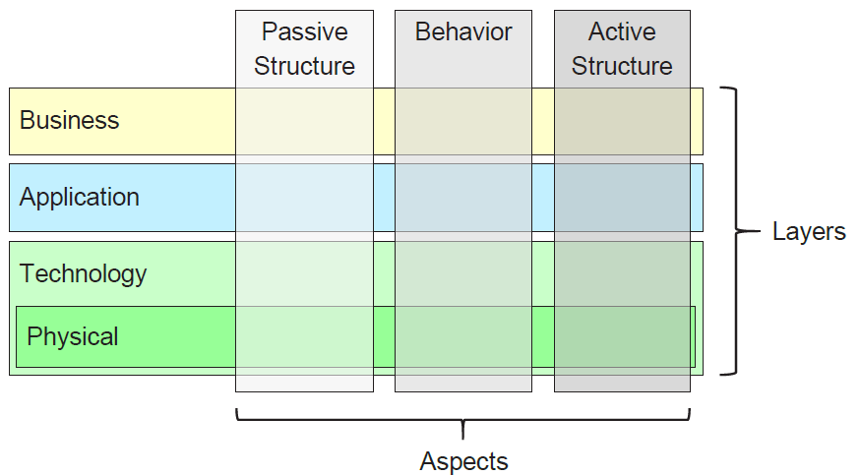
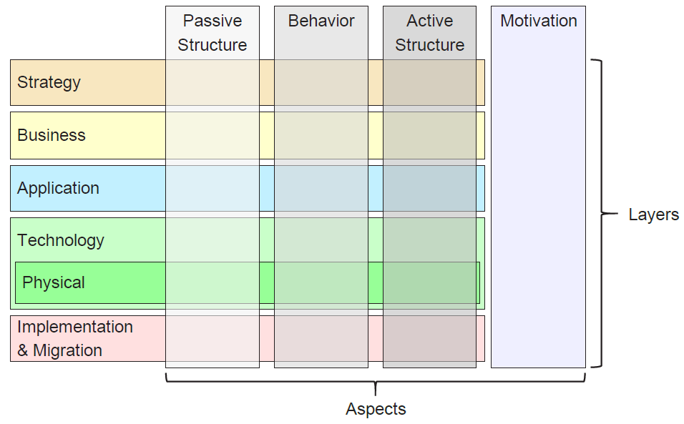
Build Ontology View on ArchiMate 3.2
008
ArchiMate Core vs. Full Framework

Slide 9
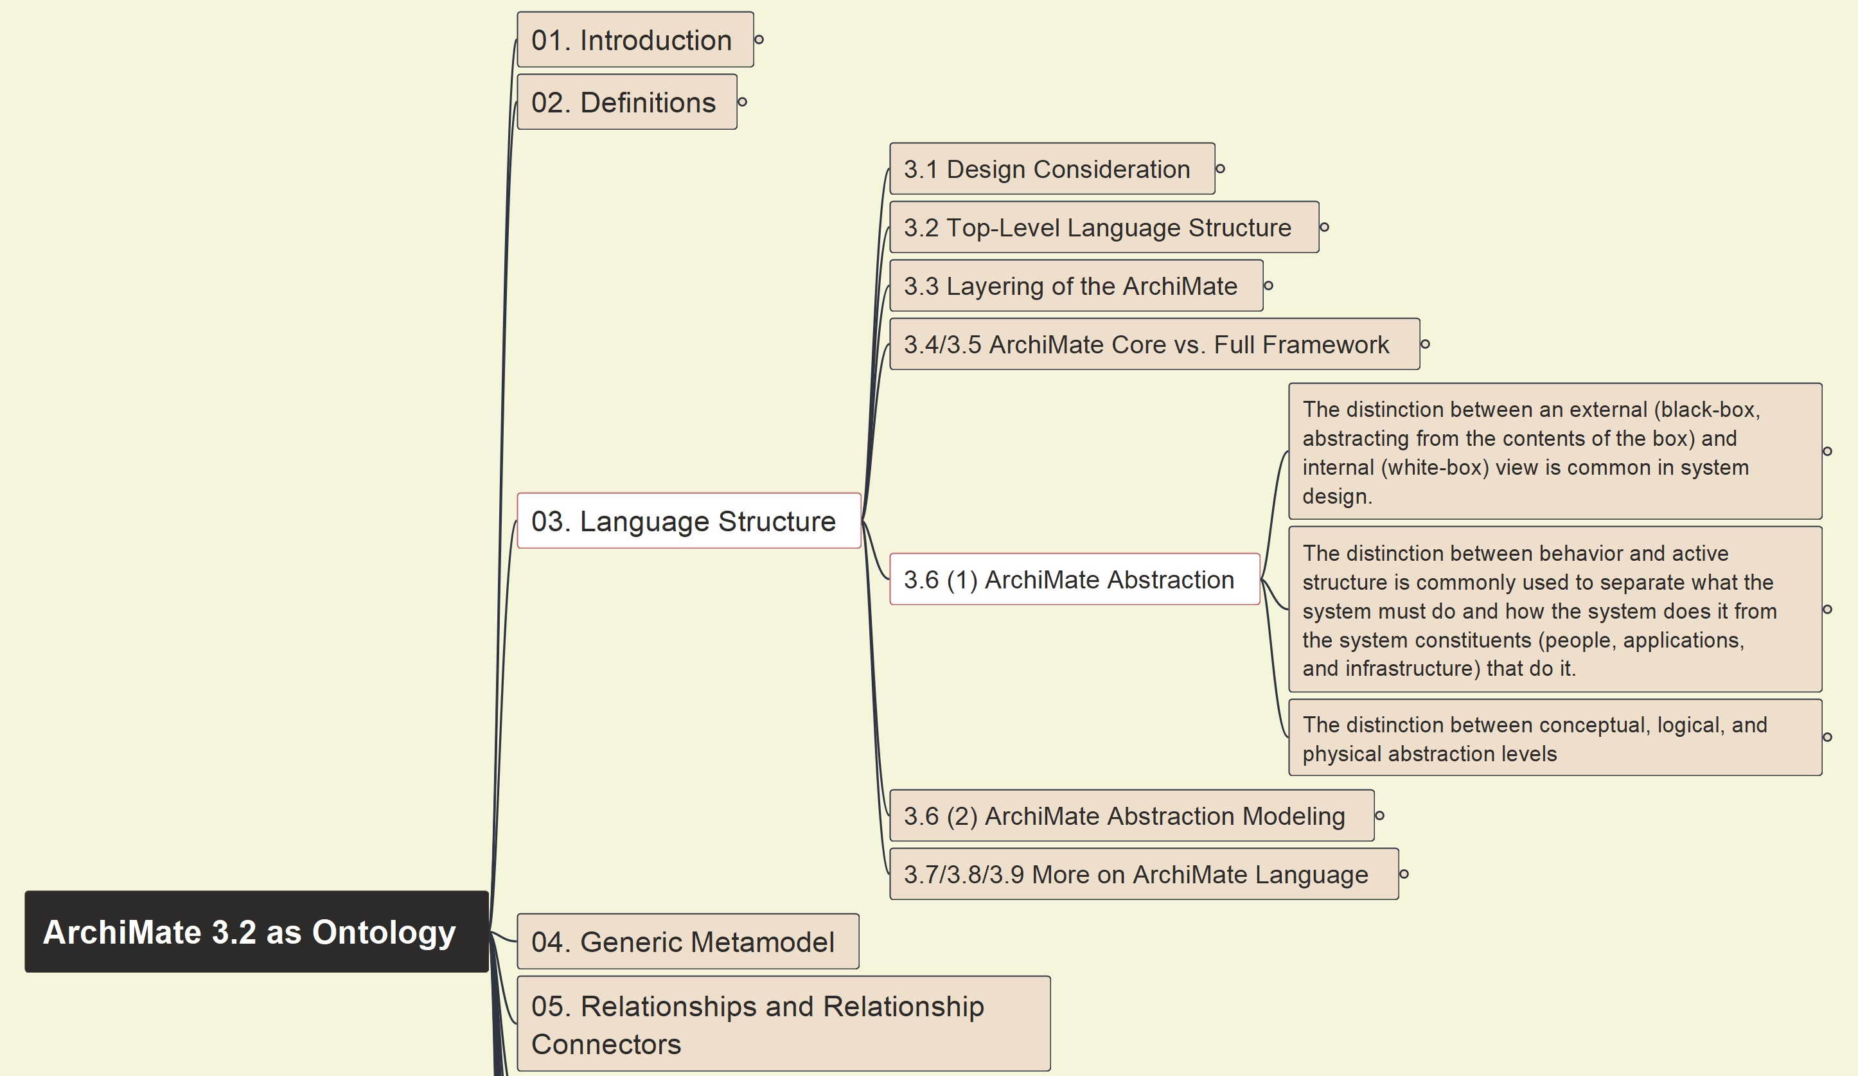
Build Ontology View on ArchiMate 3.2
009
ArchiMate Language Abstraction

Slide 10
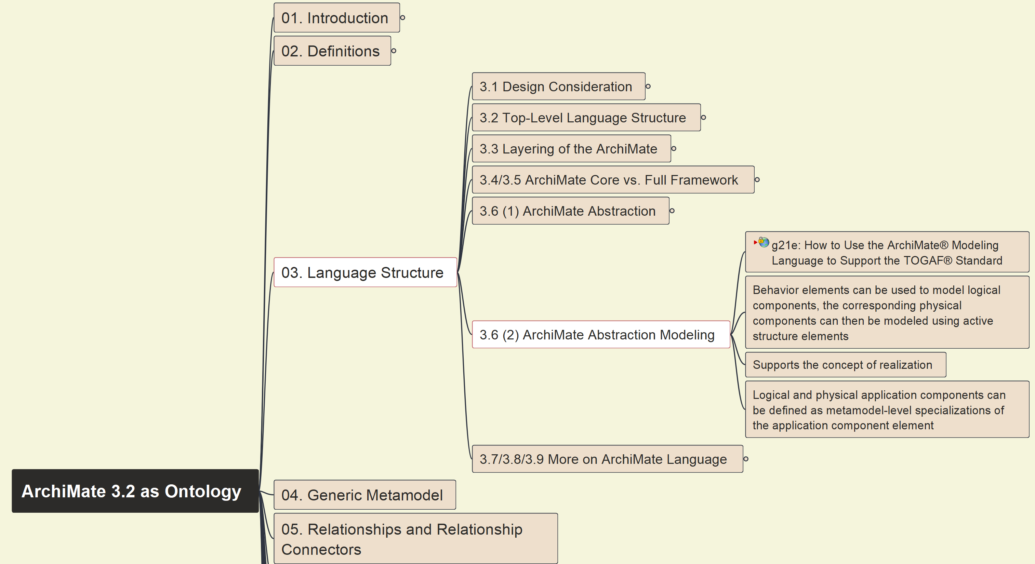
Build Ontology View on ArchiMate 3.2
010
ArchiMate Abstraction and Modeling

Slide 11
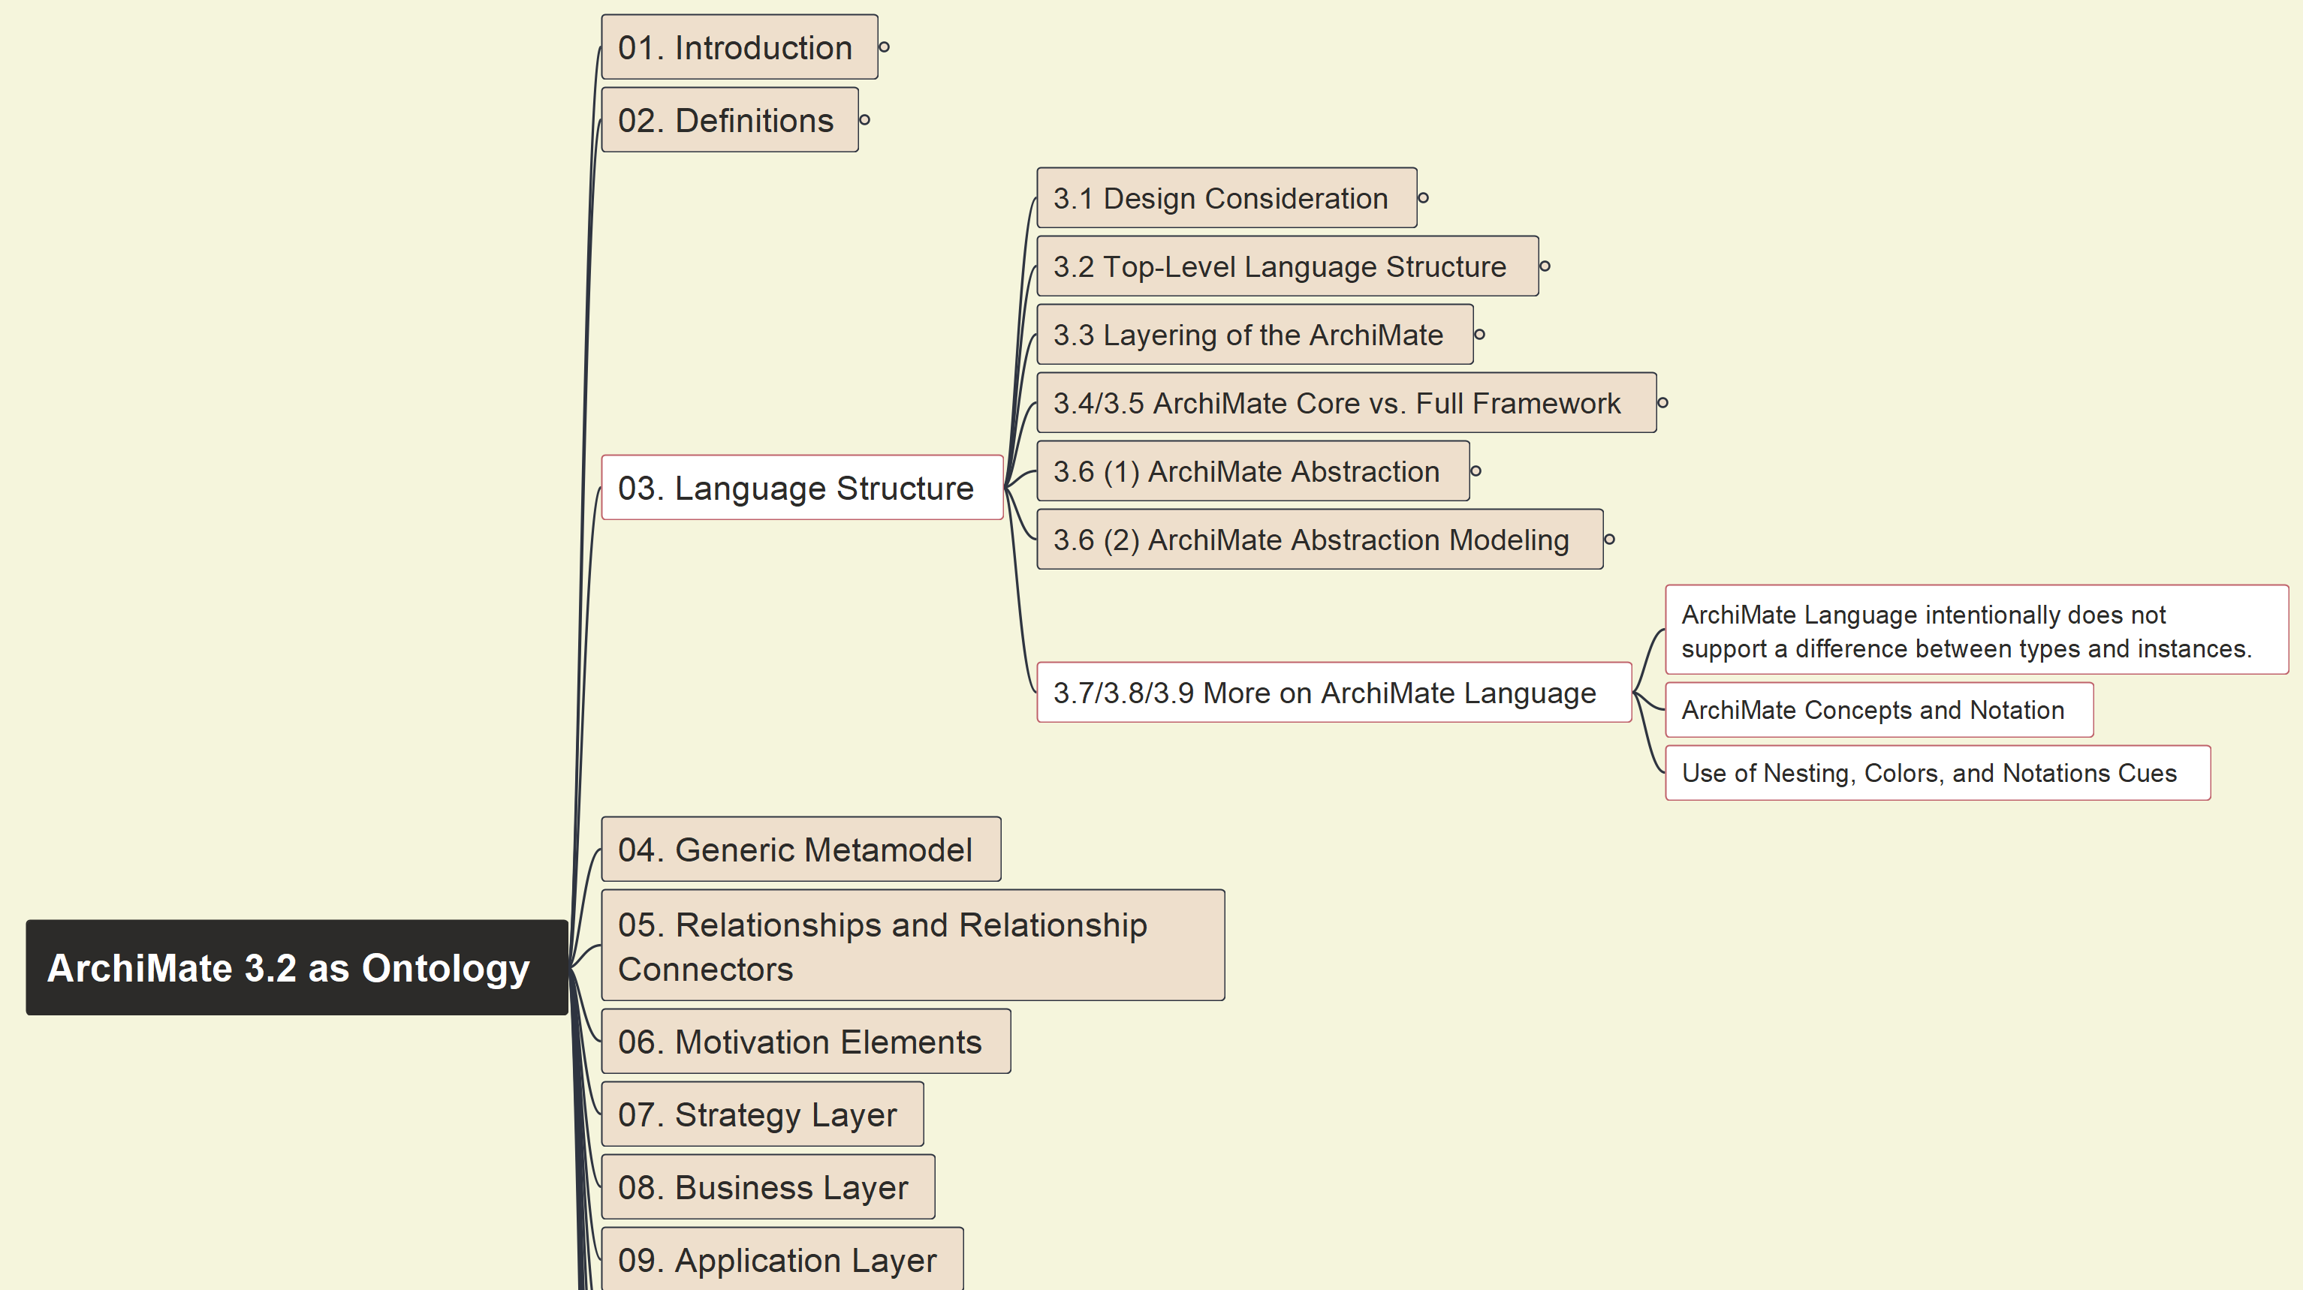
Build Ontology View on ArchiMate 3.2
011
More on ArchiMate Language Structure

Slide 12
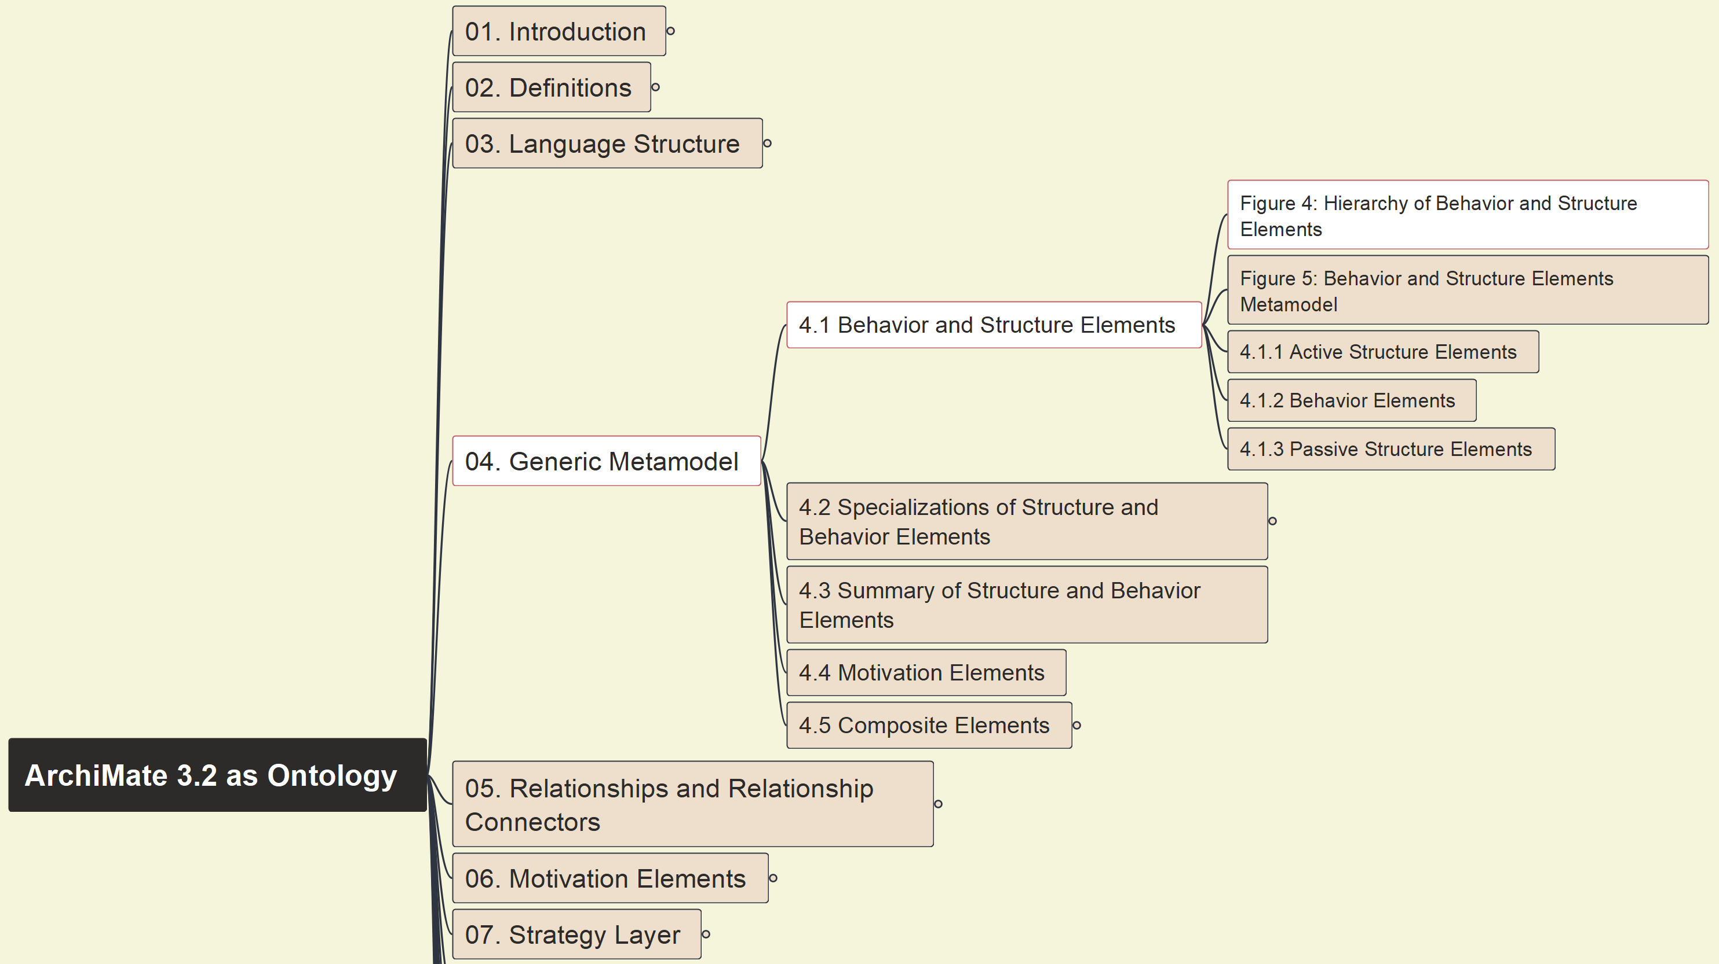
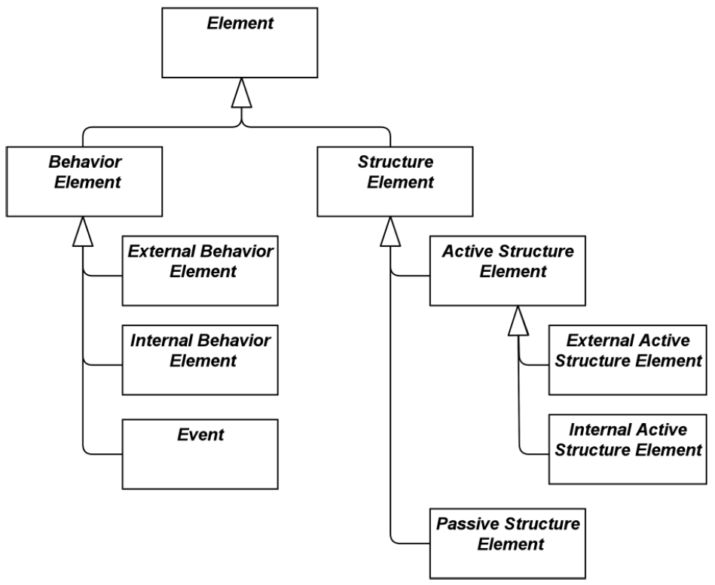
Build Ontology View on ArchiMate 3.2
012
4.1 Behavior and Structure Elements (1)

Slide 13
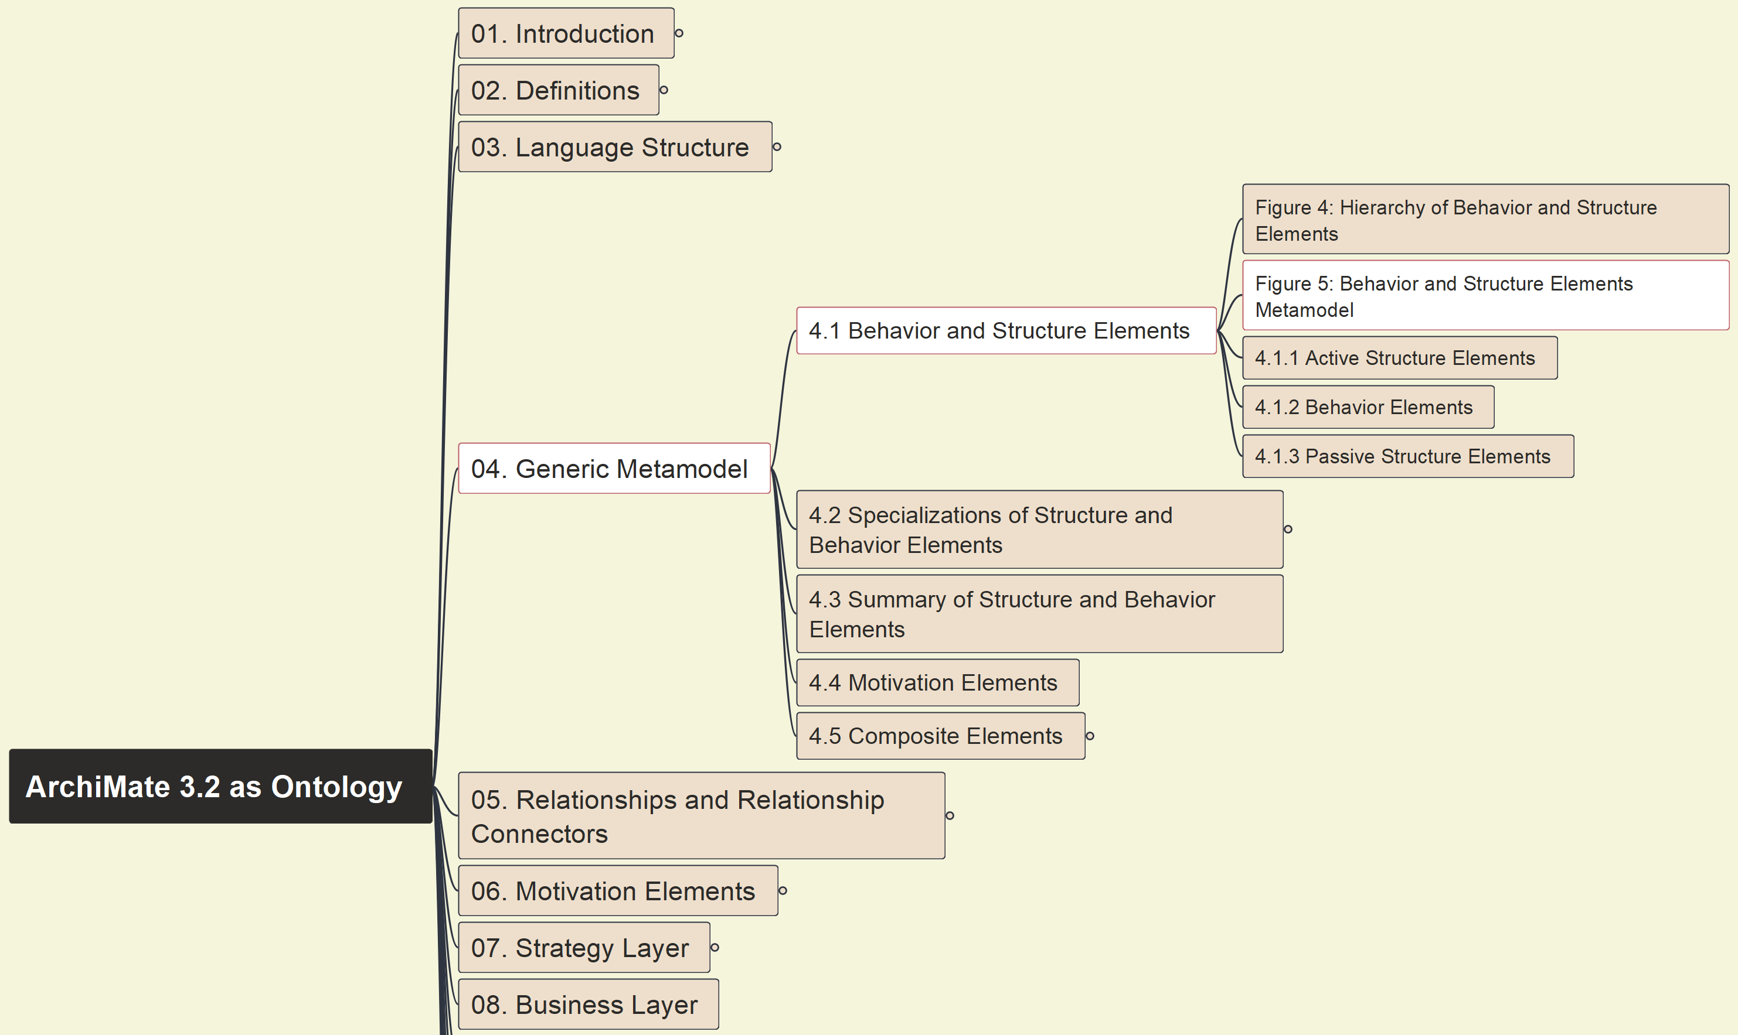
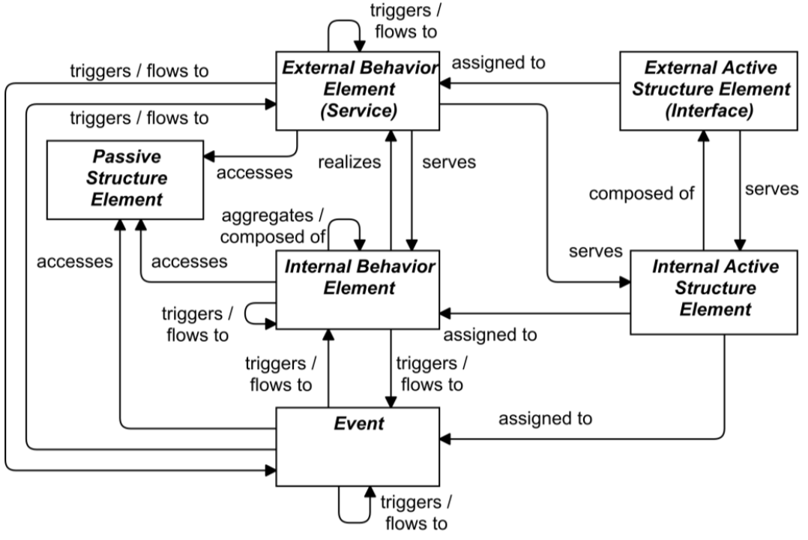
Build Ontology View on ArchiMate 3.2
013
4.1 Behavior and Structure Elements (2)

Slide 14
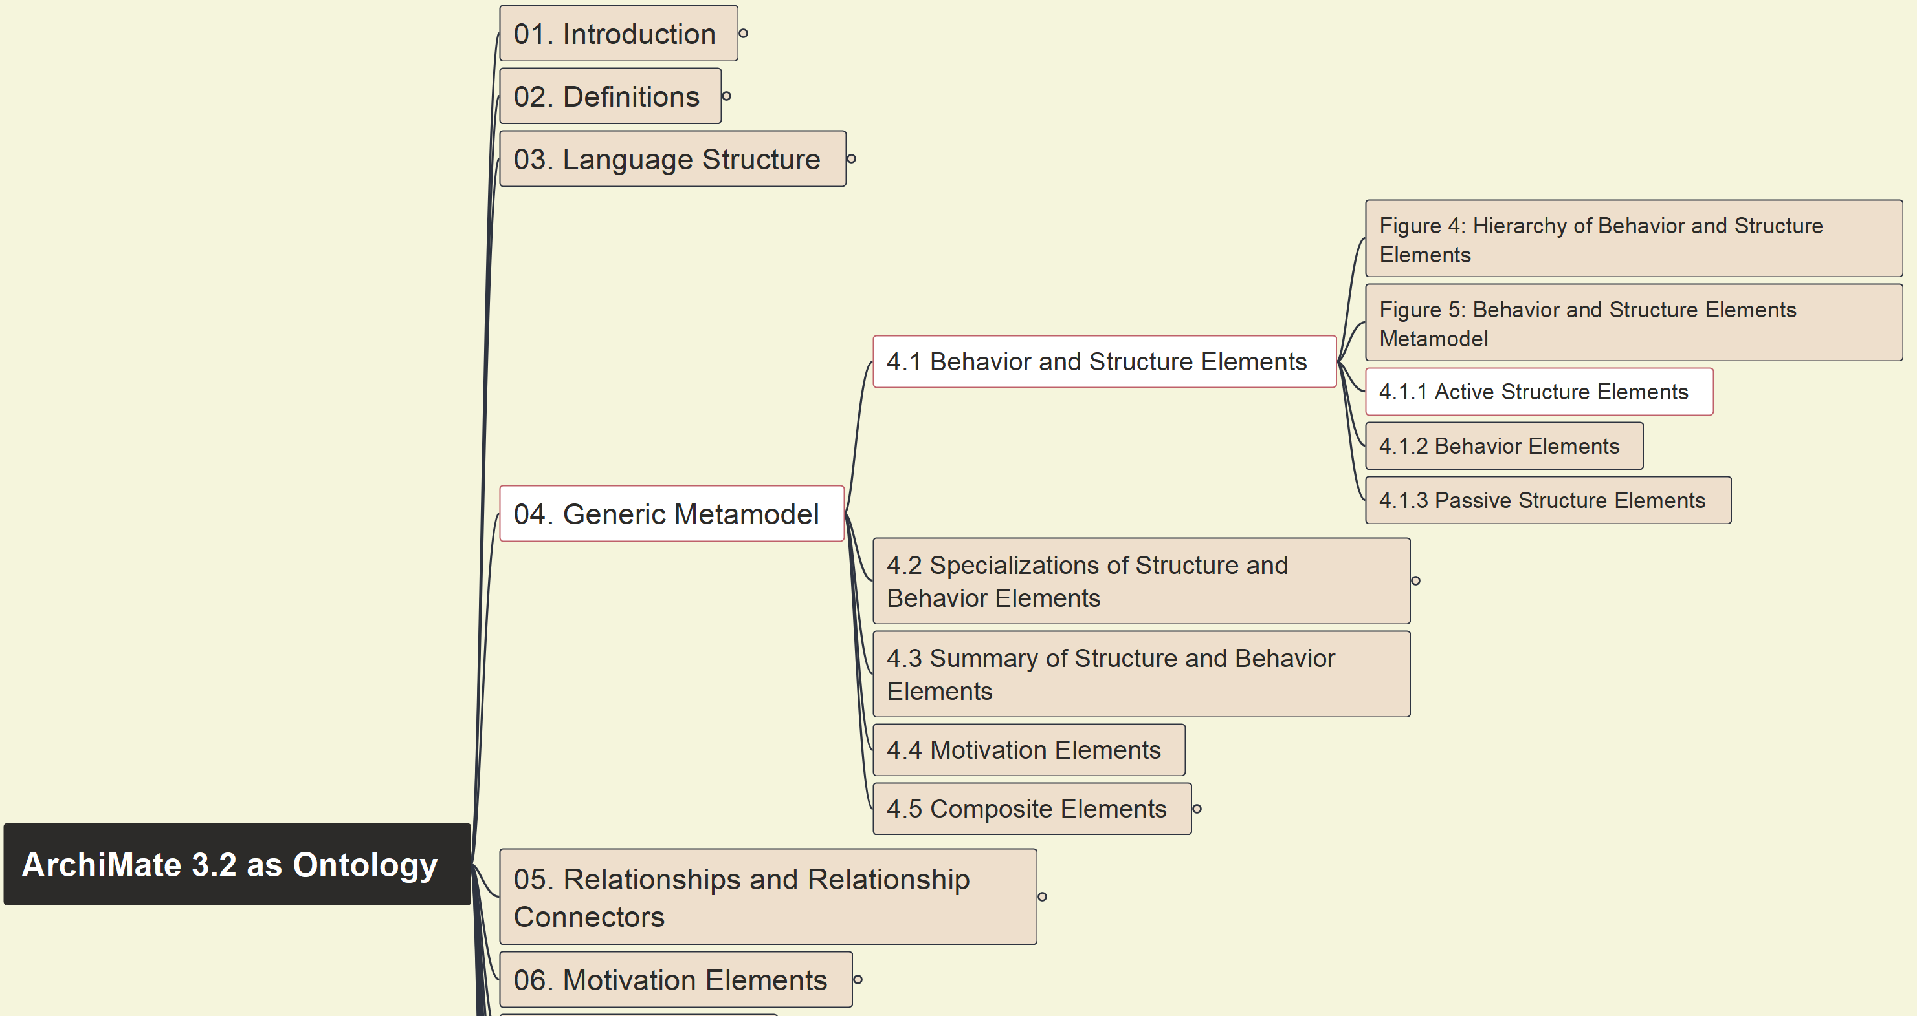
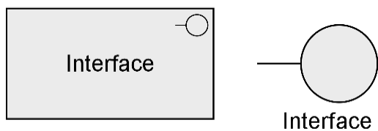

Build Ontology View on ArchiMate 3.2
014
4.1.1 Active Structure Elements

Slide 15
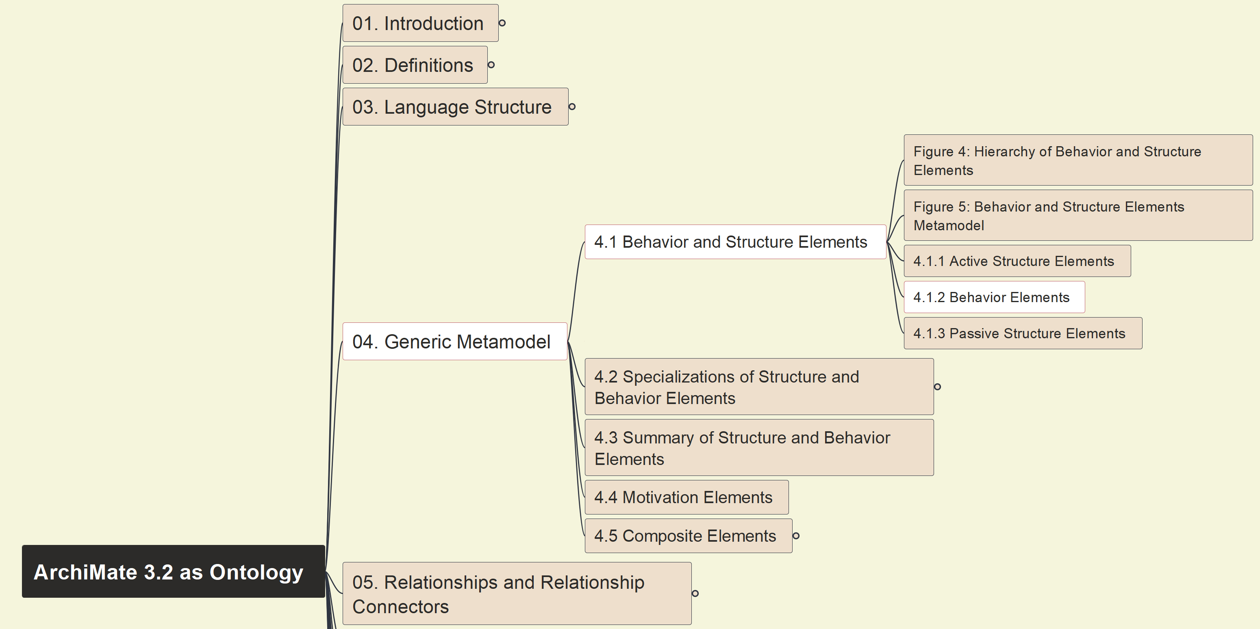
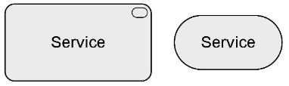
Build Ontology View on ArchiMate 3.2
015
4.1.2 Behavior Elements

Slide 16
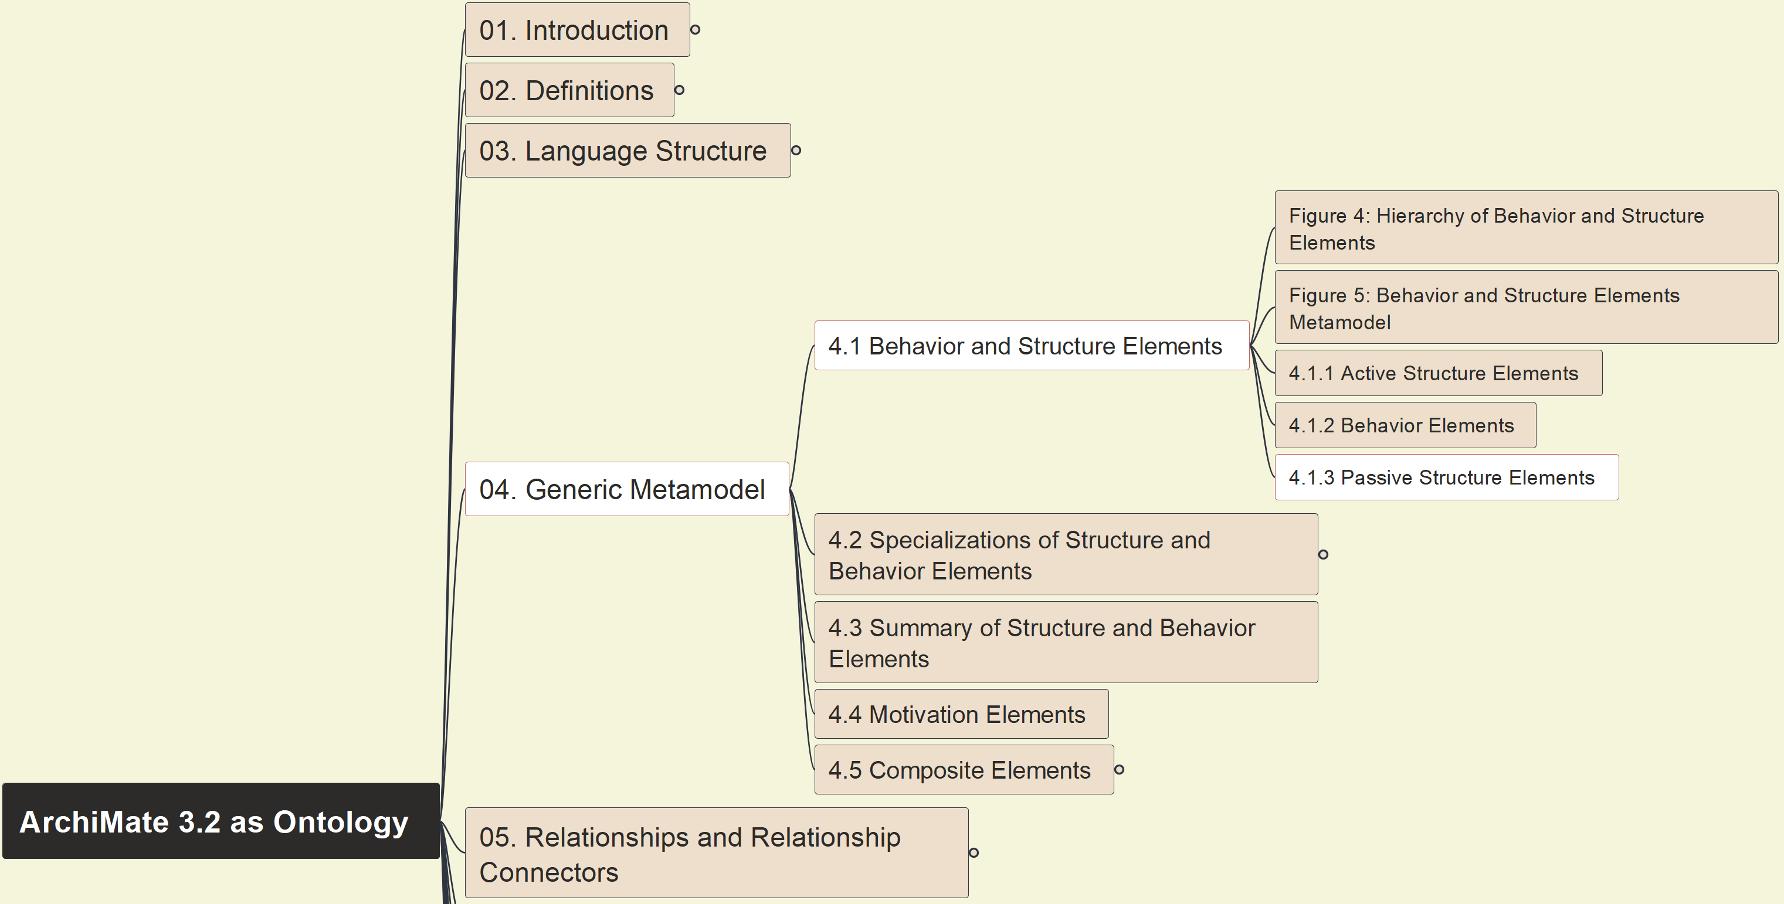
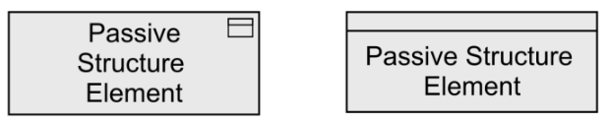
Build Ontology View on ArchiMate 3.2
016
4.1.3 Passive Structure Elements

Slide 17
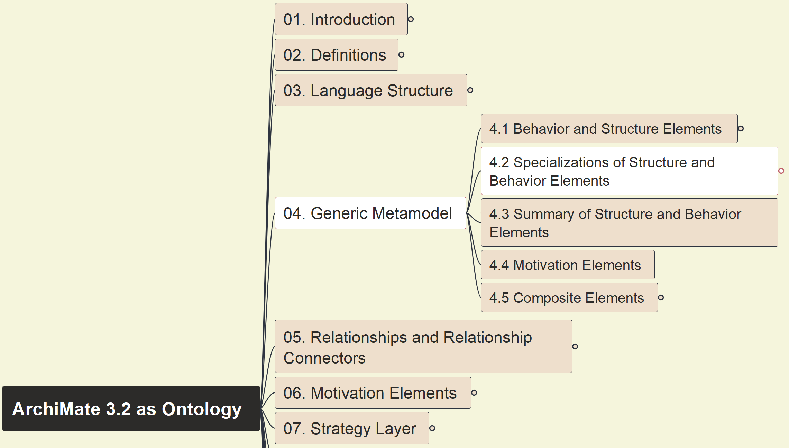
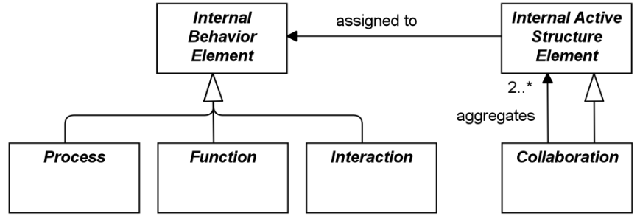
Build Ontology View on ArchiMate 3.2
017
4.2 Specialization of Structure and Behavior Element

Slide 18
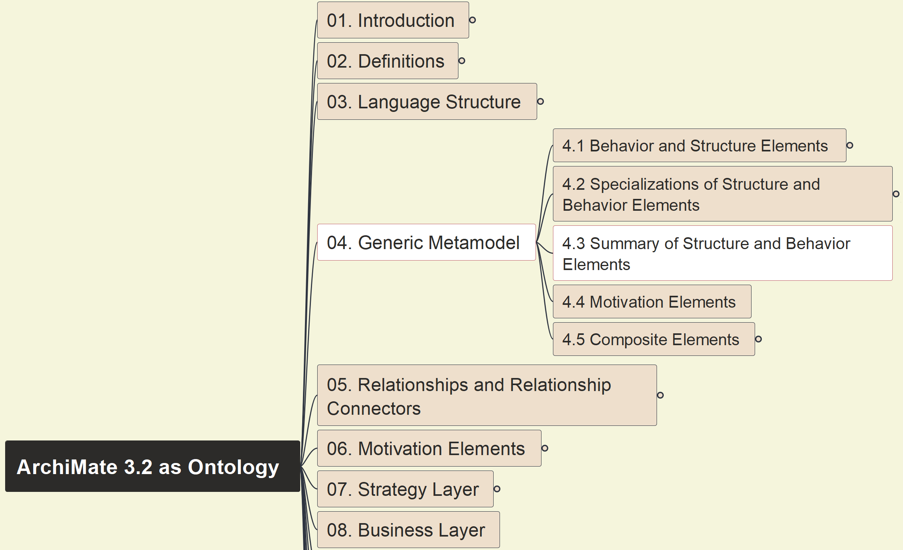
Build Ontology View on ArchiMate 3.2
018
4.3 Summary of Structure and Behavior Elements

Slide 19
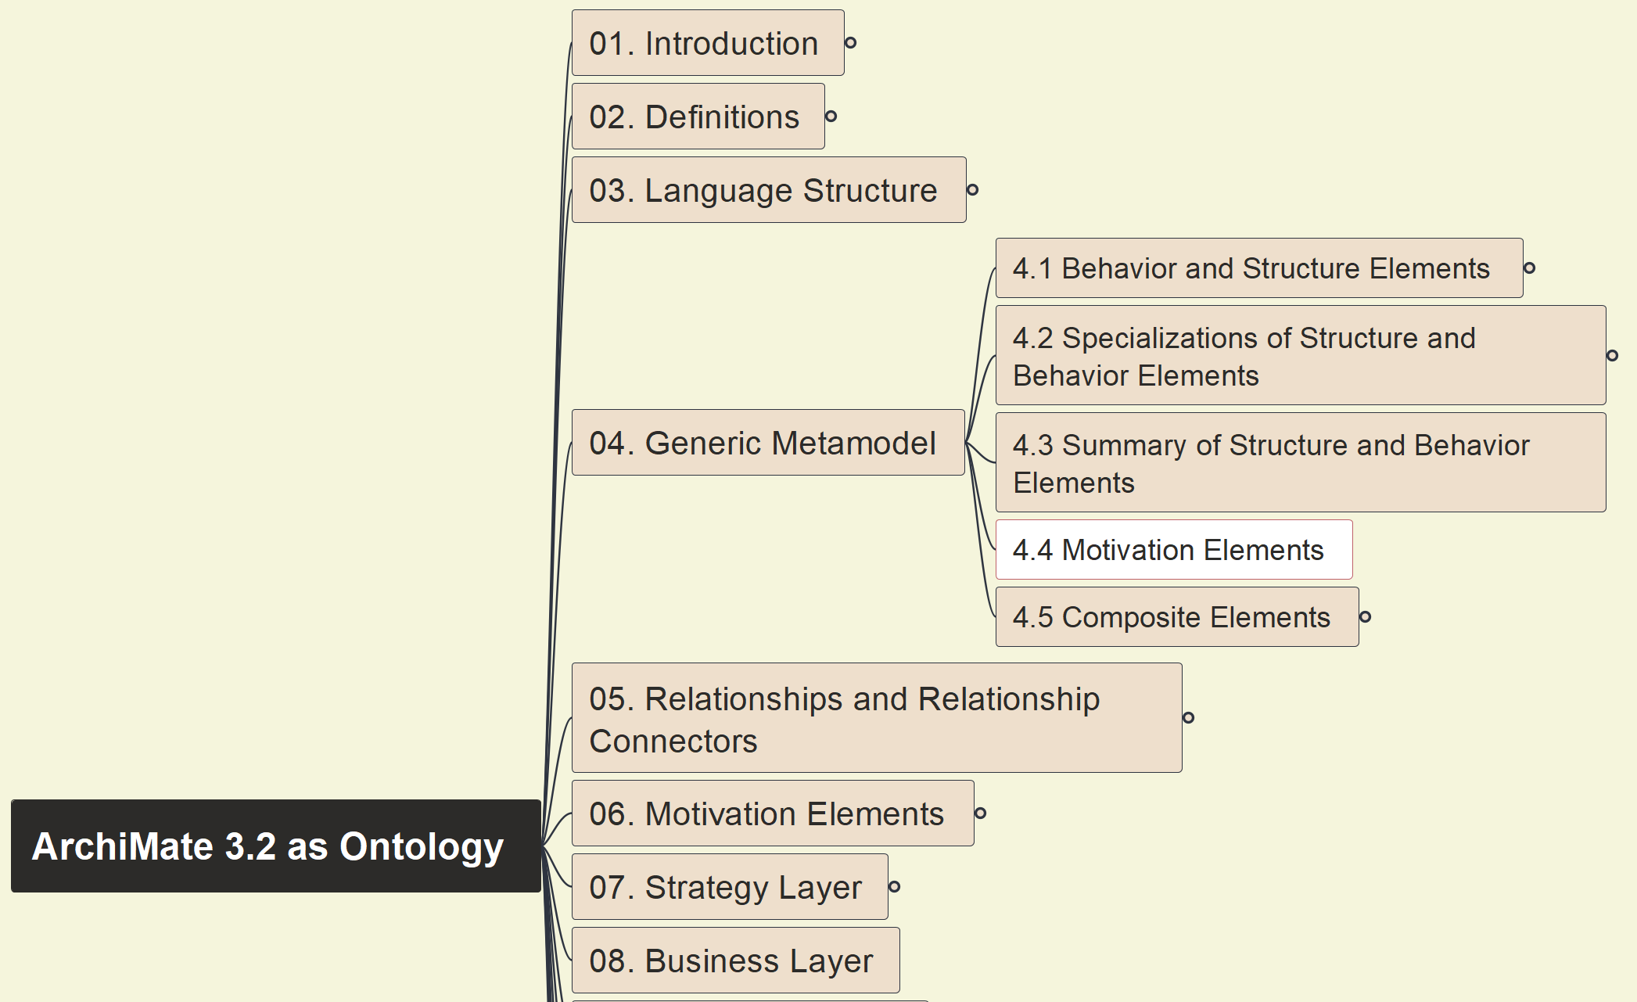
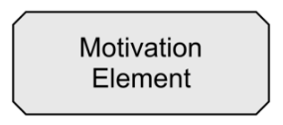
Build Ontology View on ArchiMate 3.2
019
4.4 Motivation Elements

Slide 20
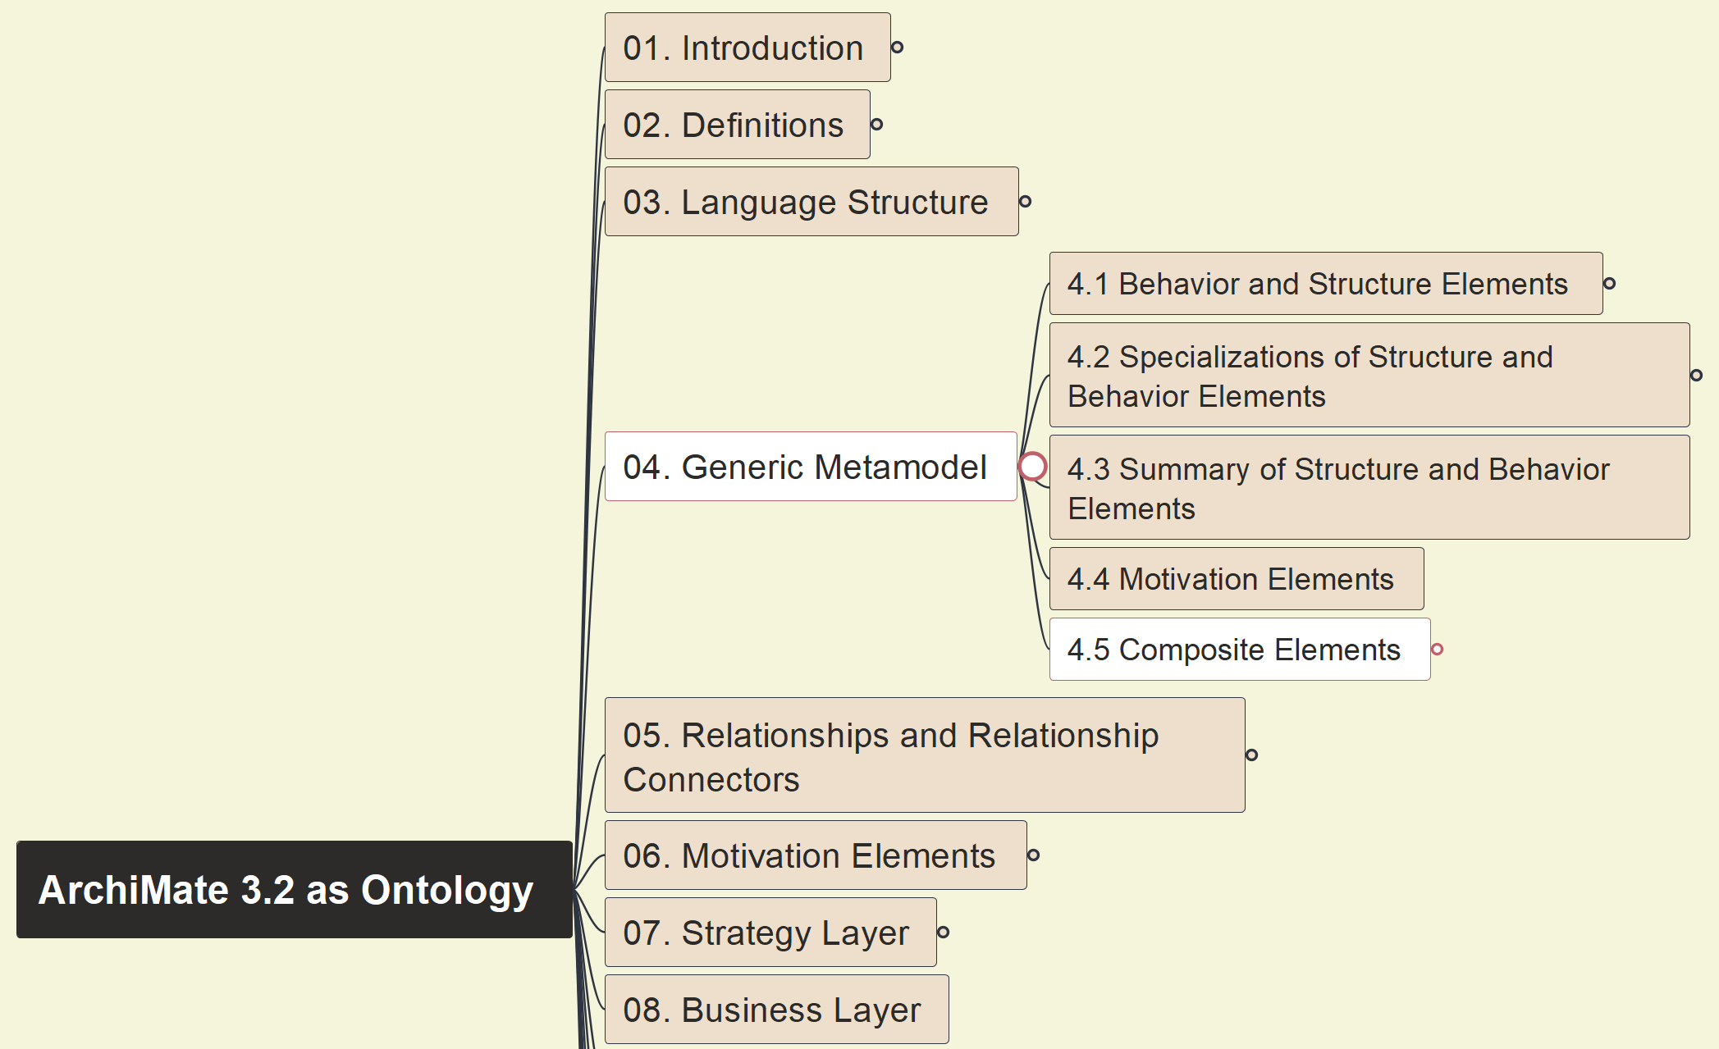
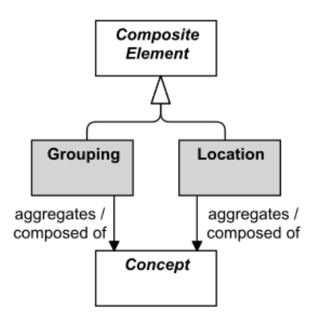
Build Ontology View on ArchiMate 3.2
020
4.5 Composite Elements

Slide 21
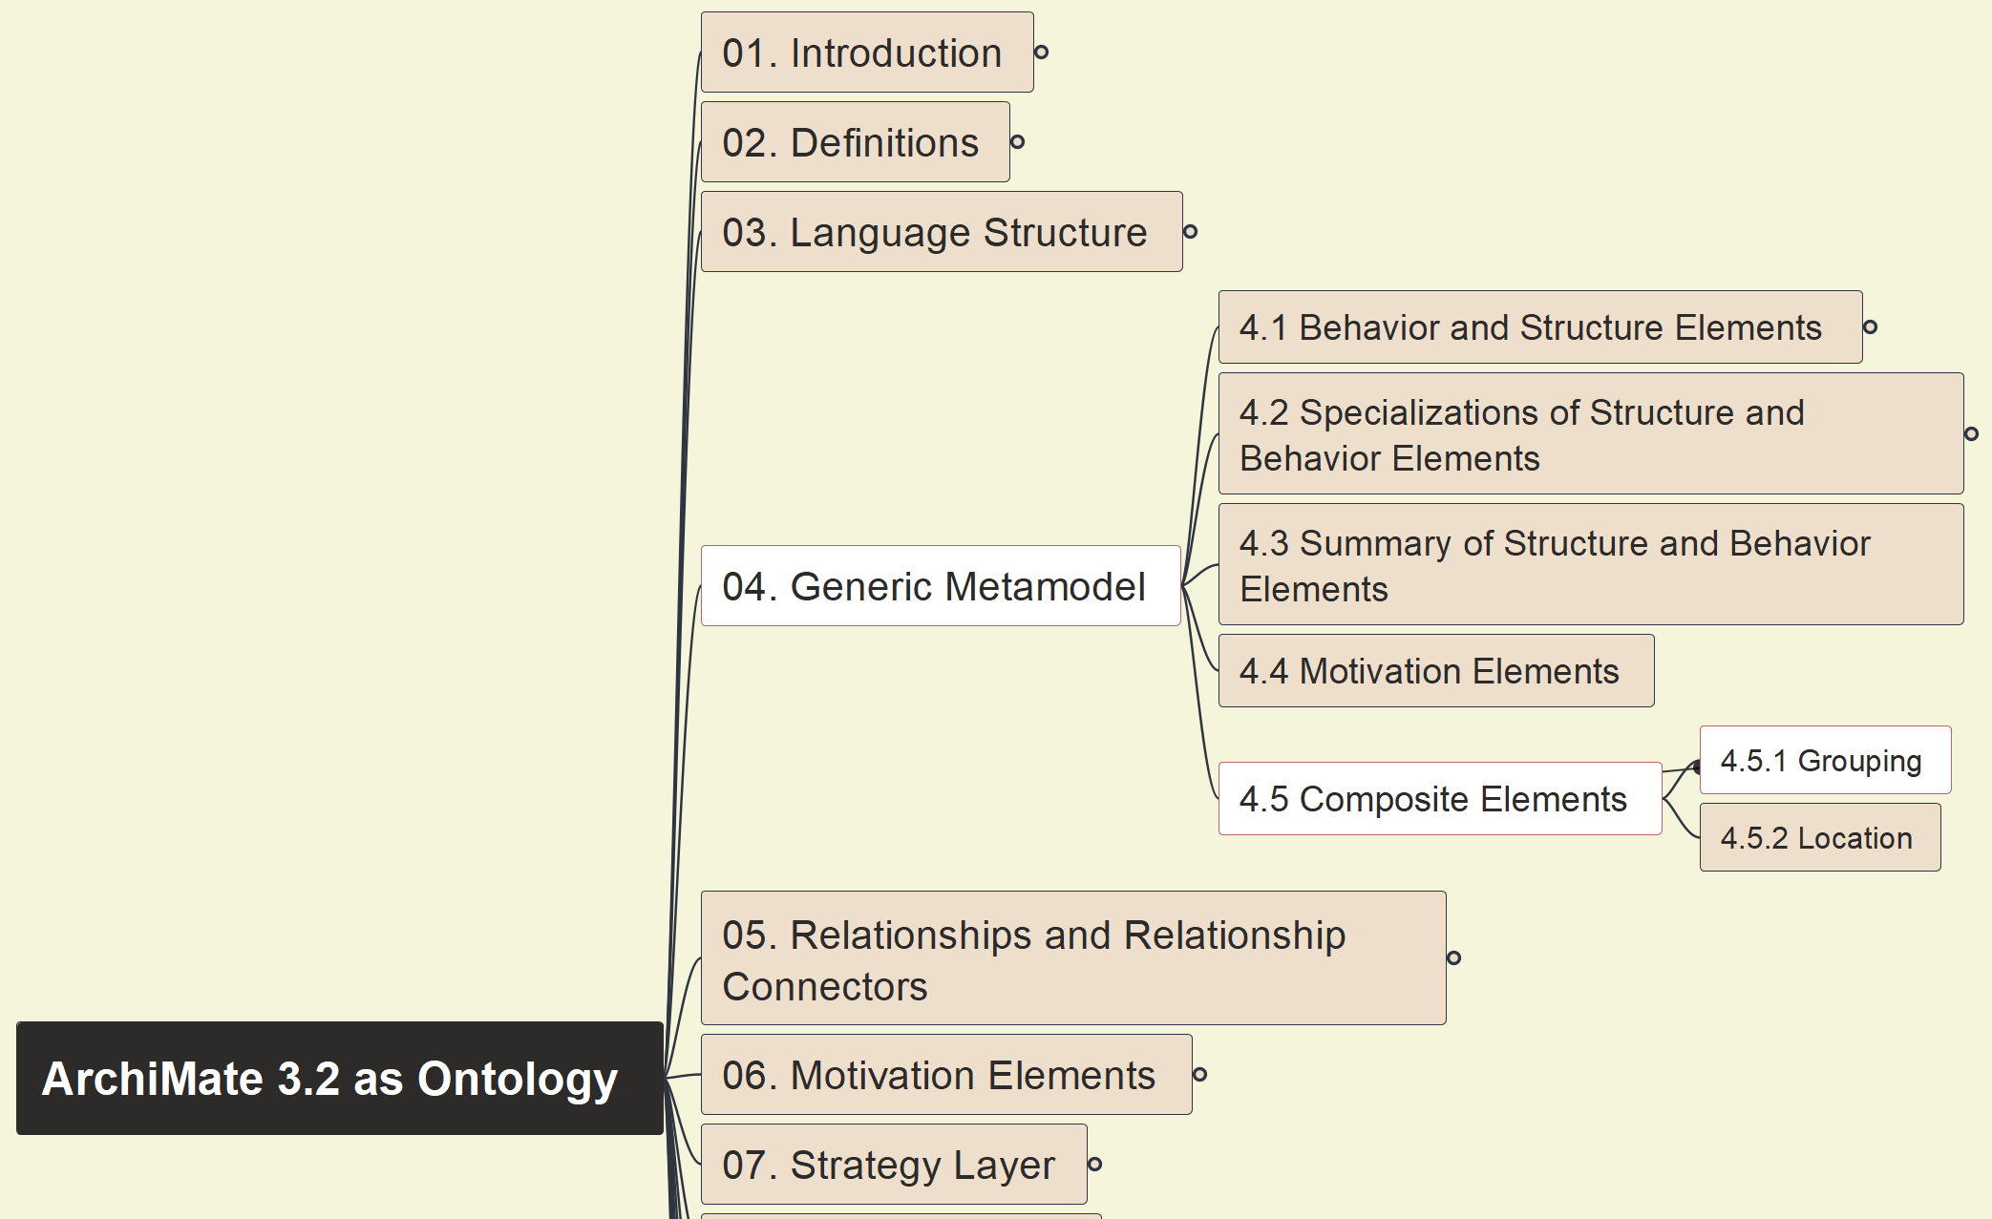
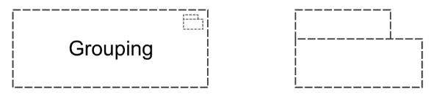
Build Ontology View on ArchiMate 3.2
021
4.5.1 Composite Elements - Grouping

Slide 22
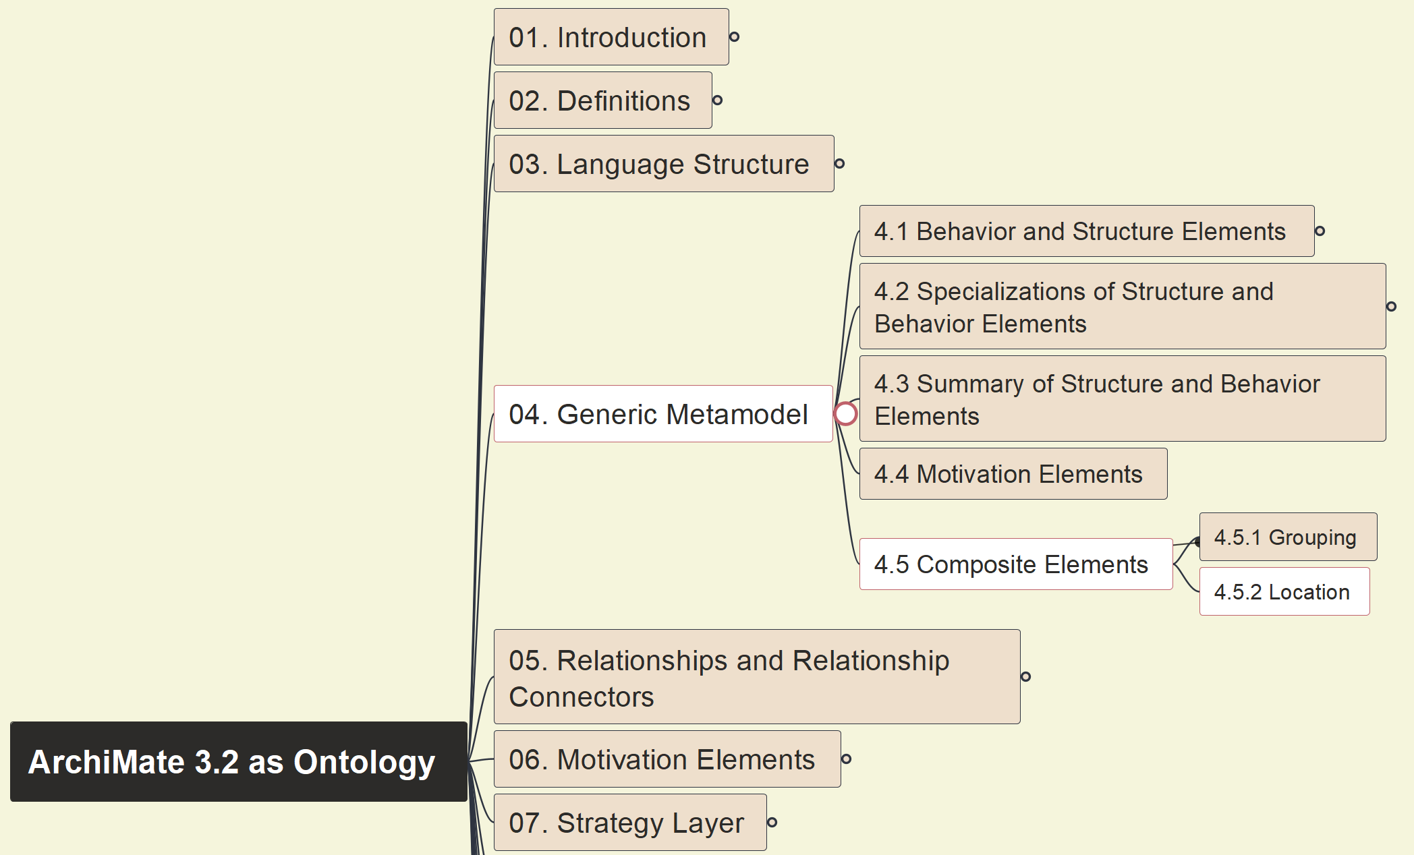
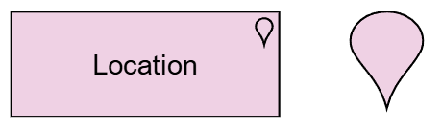
Build Ontology View on ArchiMate 3.2
022
4.5.2 Composite Elements - Location

Slide 23
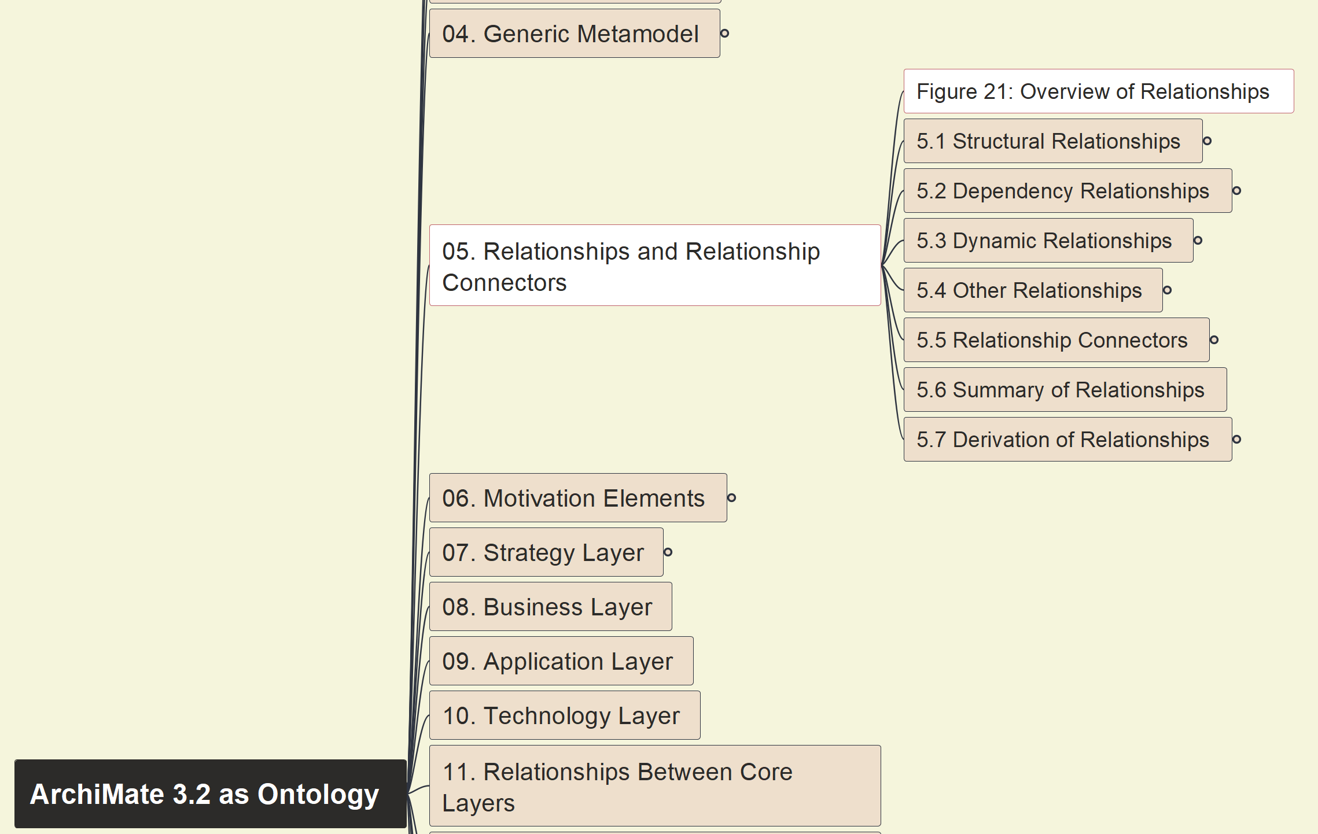
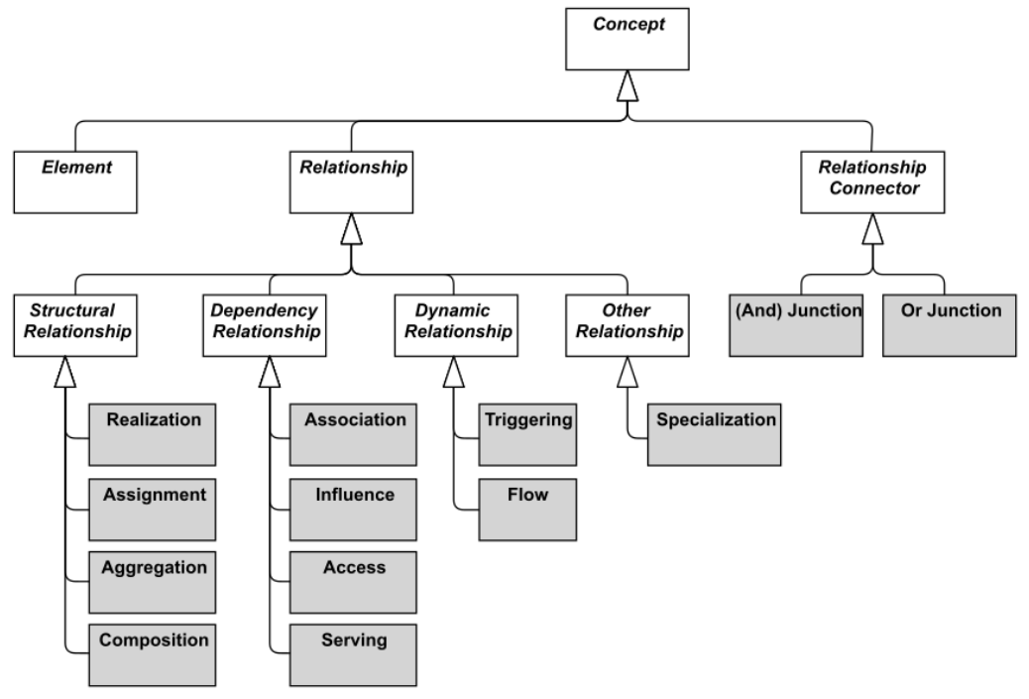
Build Ontology View on ArchiMate 3.2
023
Overview of Relationships

Slide 24
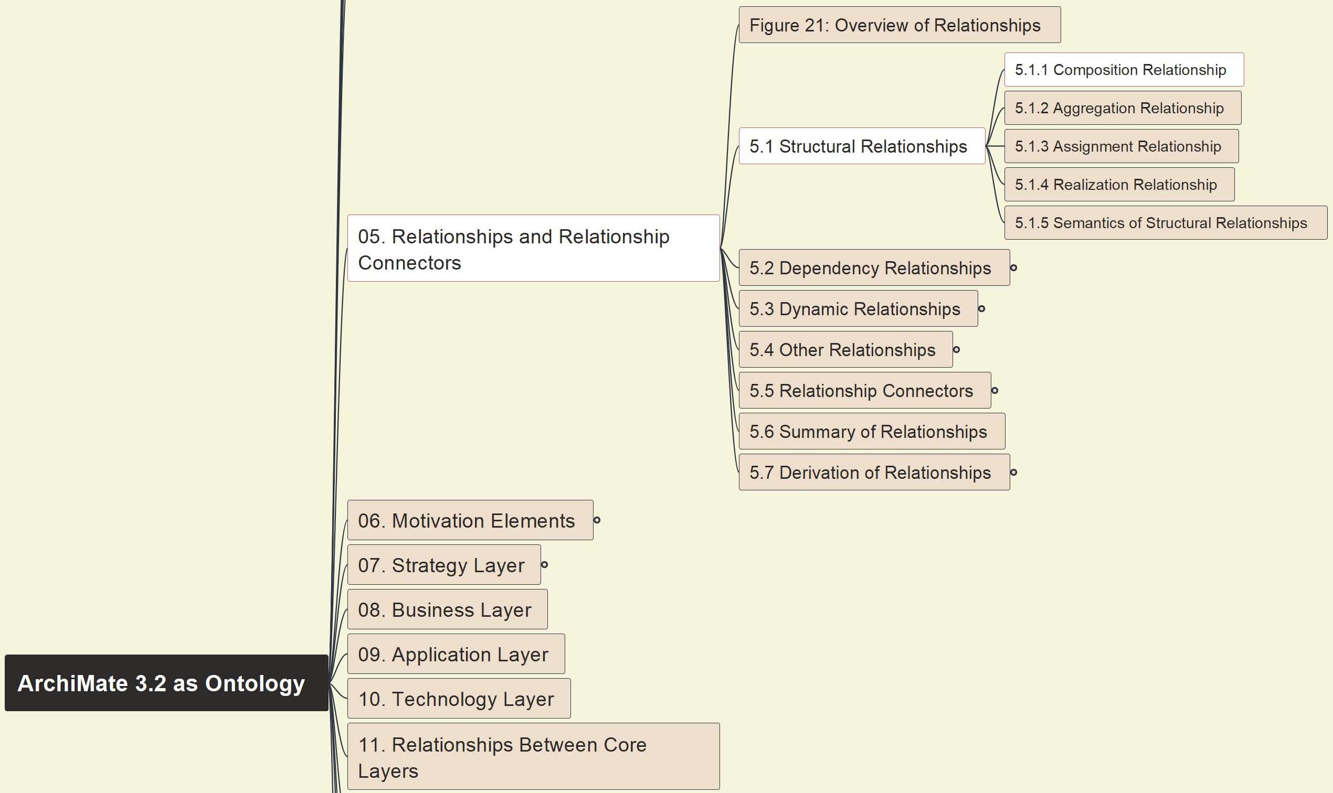
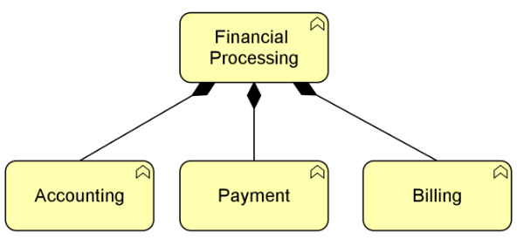
Build Ontology View on ArchiMate 3.2
024
5.1 Structural 5.1.1 Composition

Slide 25
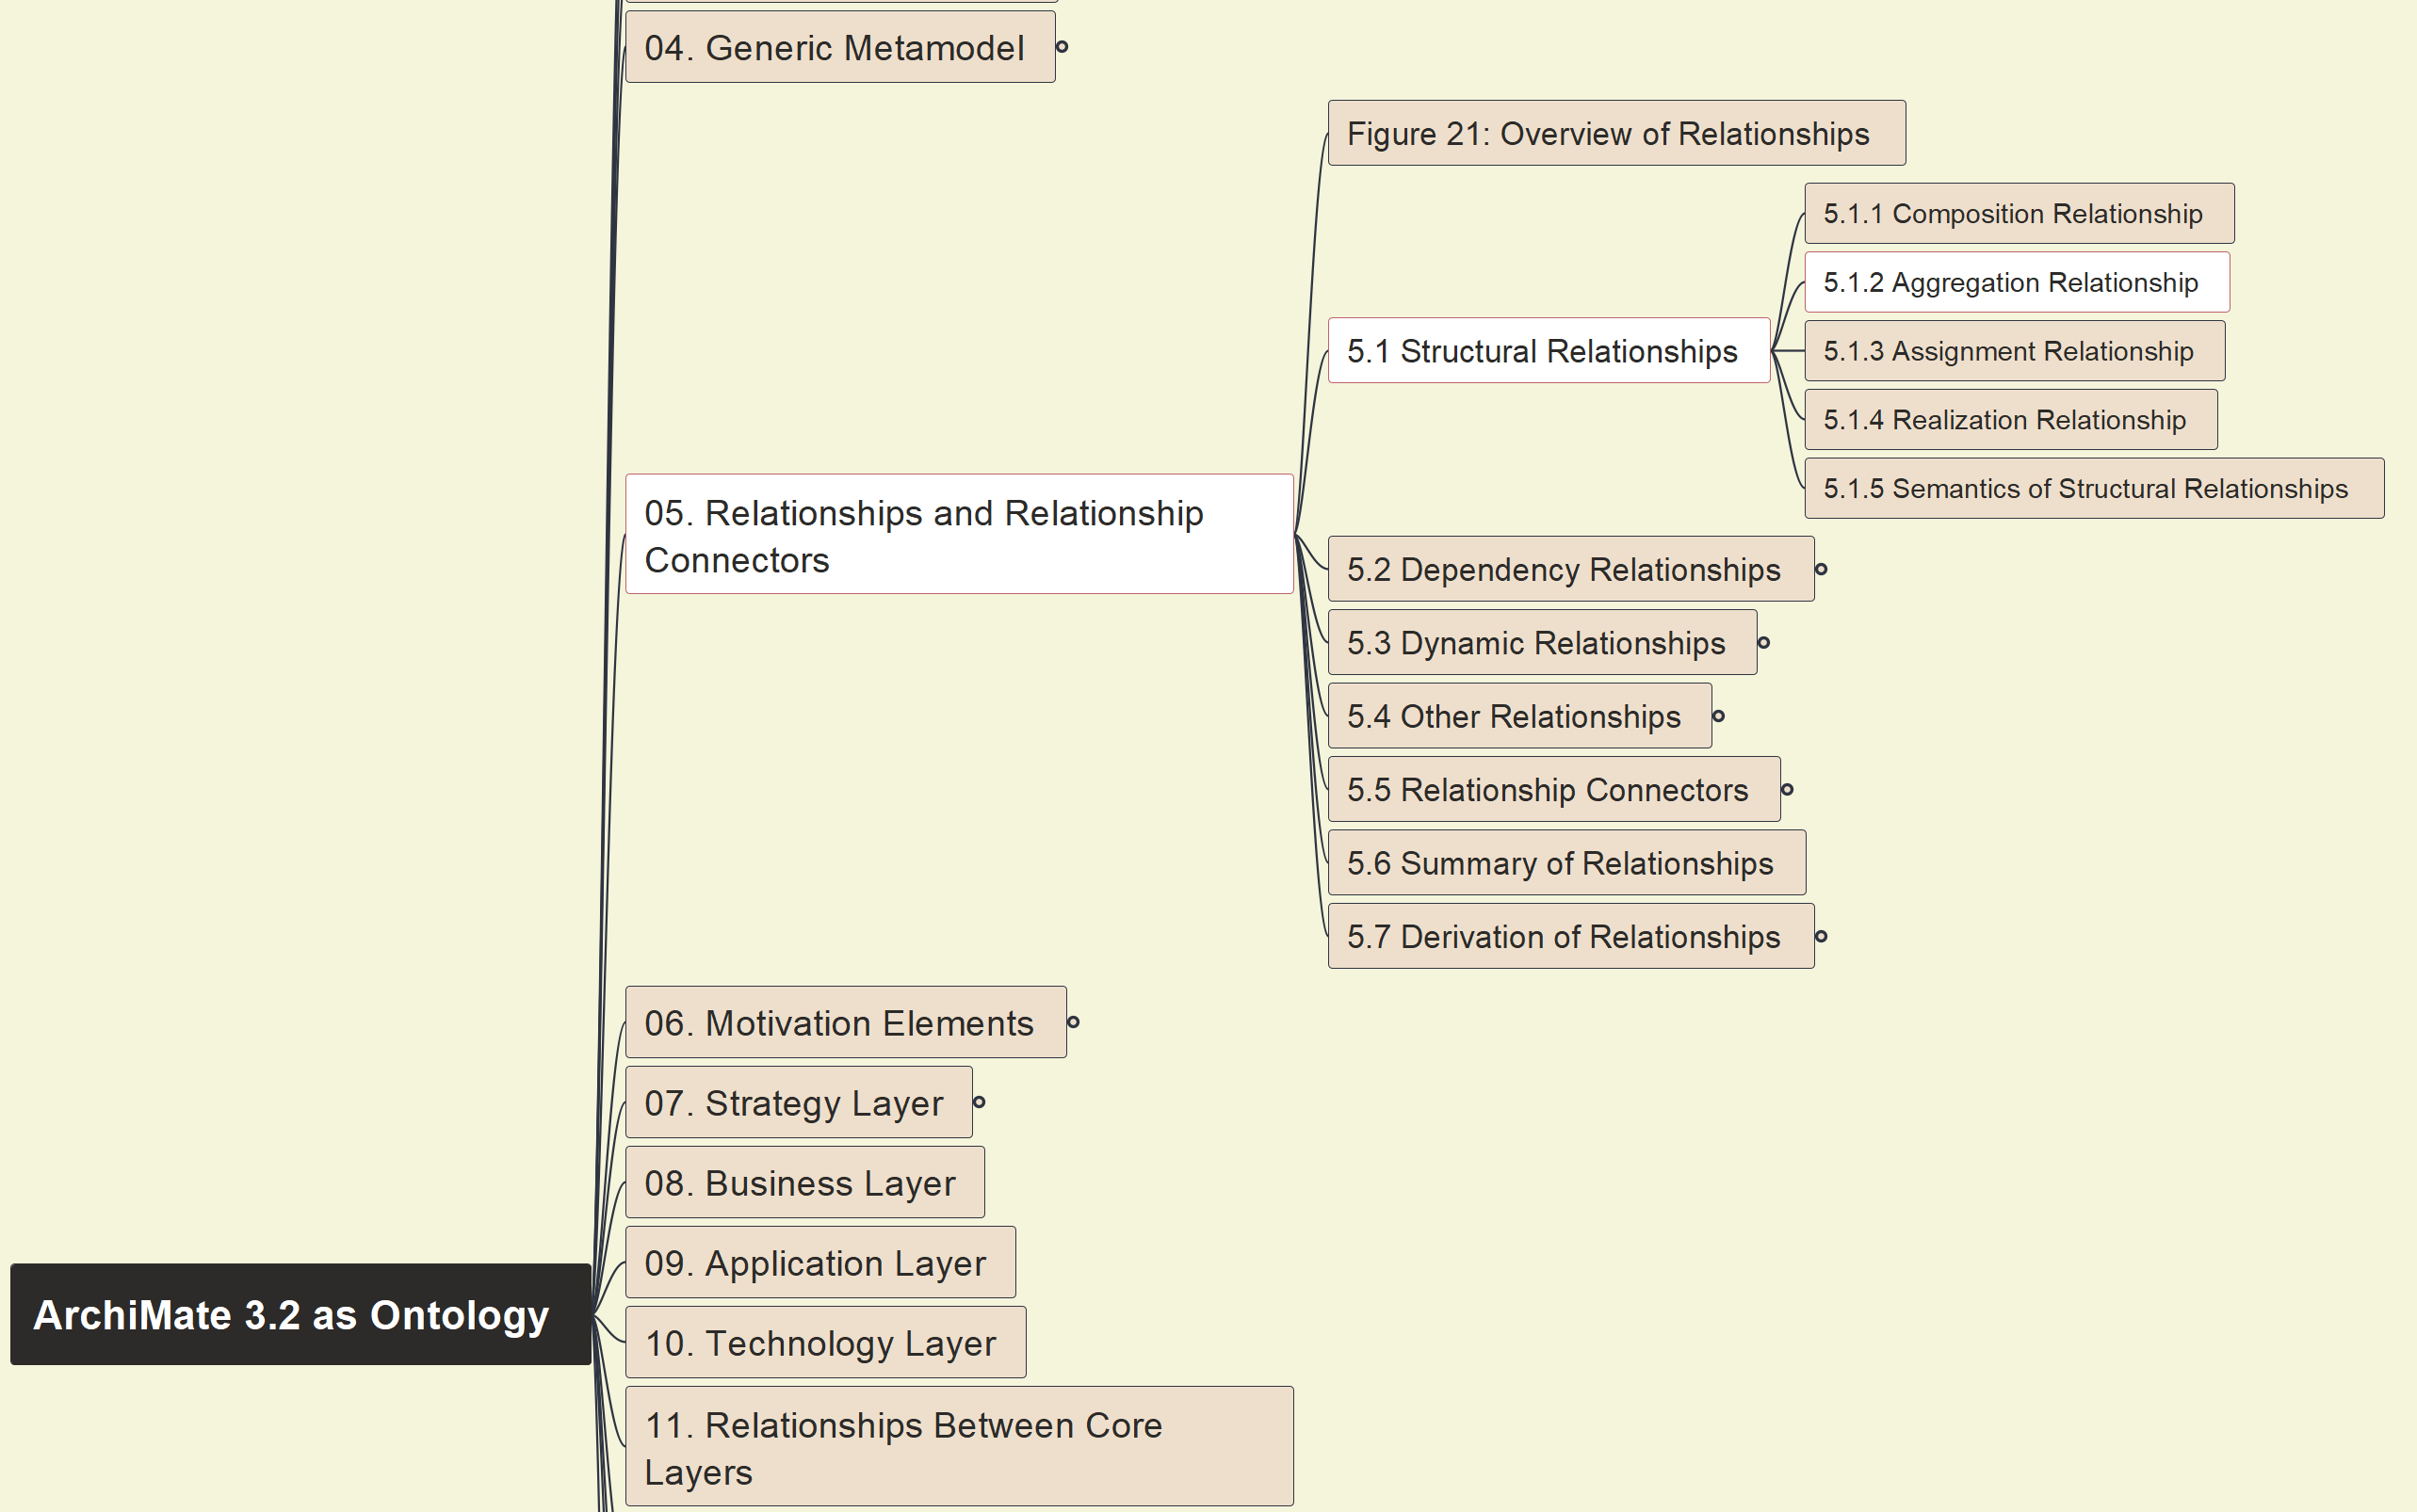
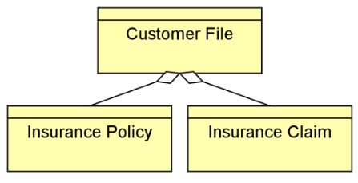
Build Ontology View on ArchiMate 3.2
025
5.1 Structural 5.1.2 Aggregation

Slide 26
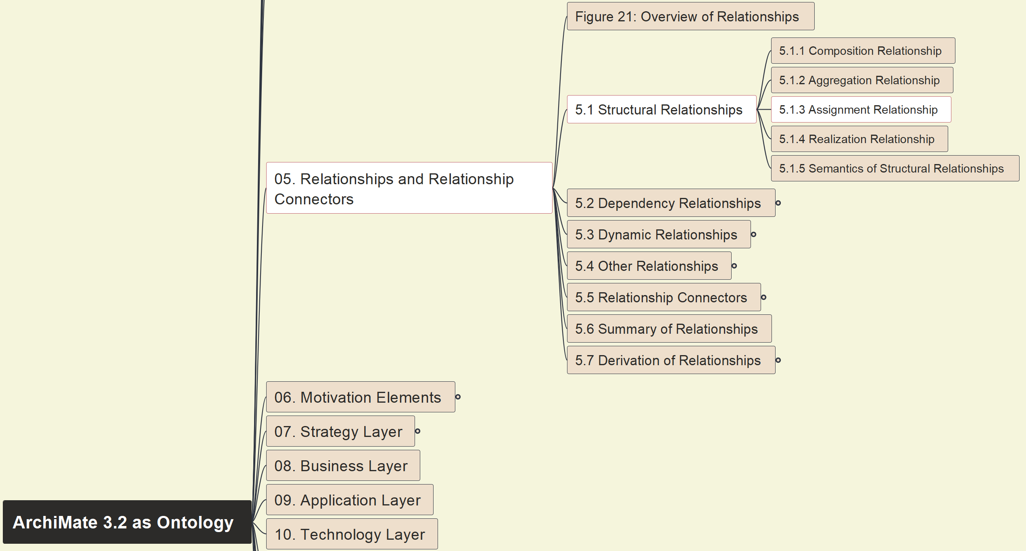
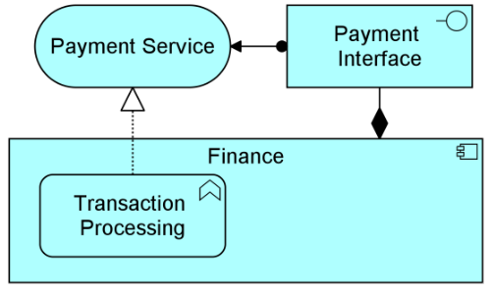
Build Ontology View on ArchiMate 3.2
026
5.1 Structural 5.1.3 Assignment

Slide 27
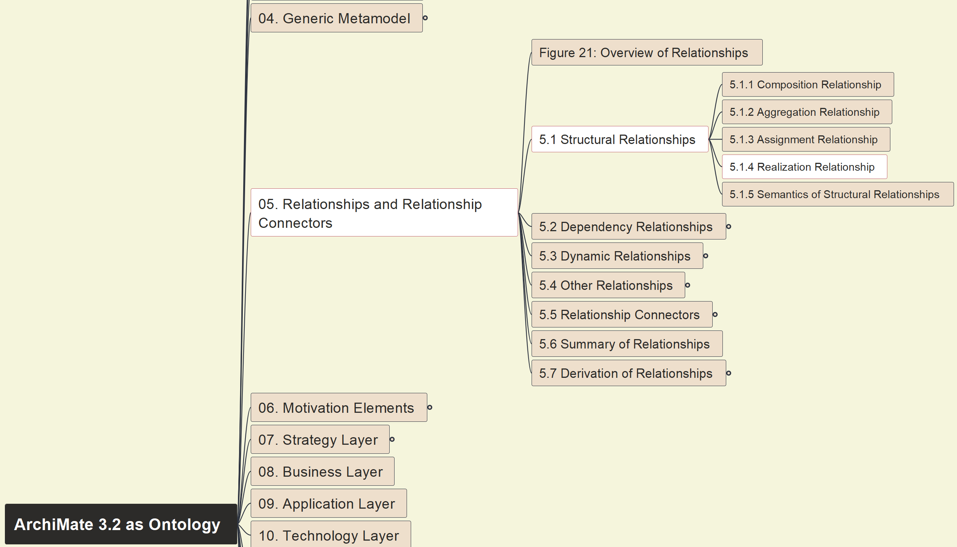
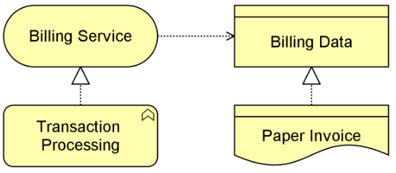
Build Ontology View on ArchiMate 3.2
027
5.1 Structural 5.1.4 Realization

Slide 28
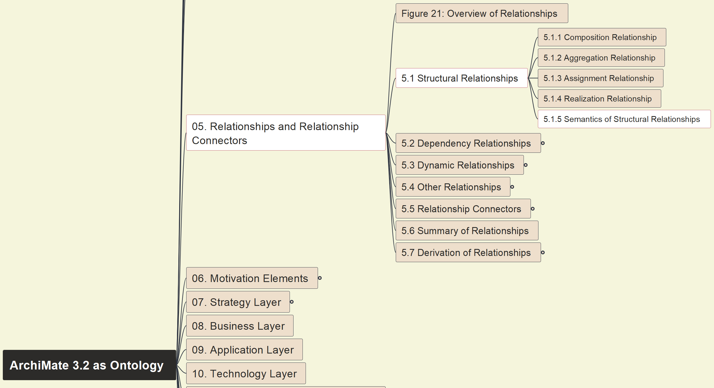
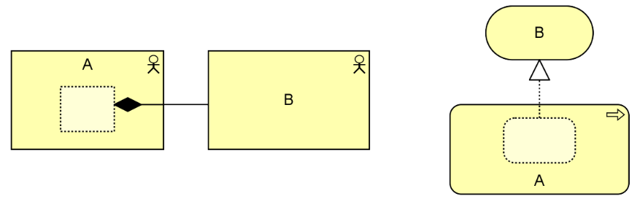
Build Ontology View on ArchiMate 3.2
028
5.1 Structural 5.1.5 Semantics View

Slide 29
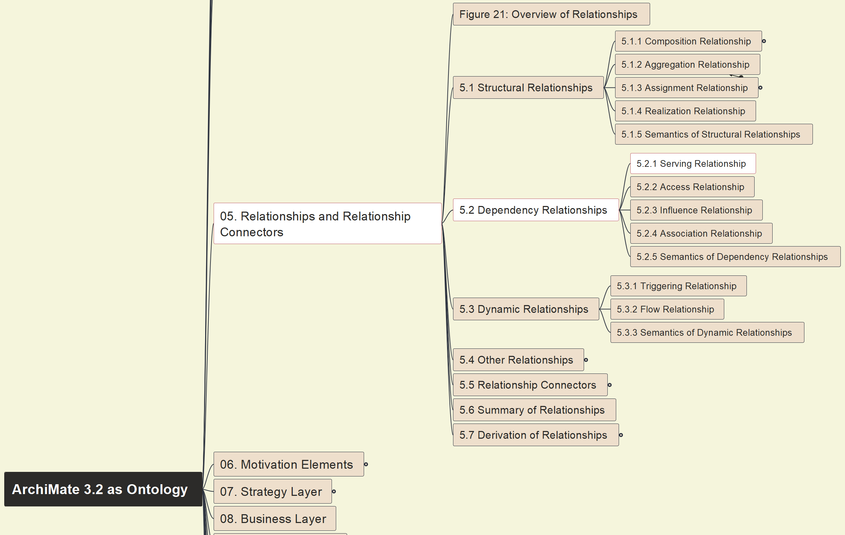
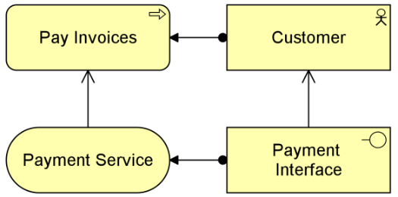
Build Ontology View on ArchiMate 3.2
029
5.2 Dependency 5.2.1 Serving

Slide 30
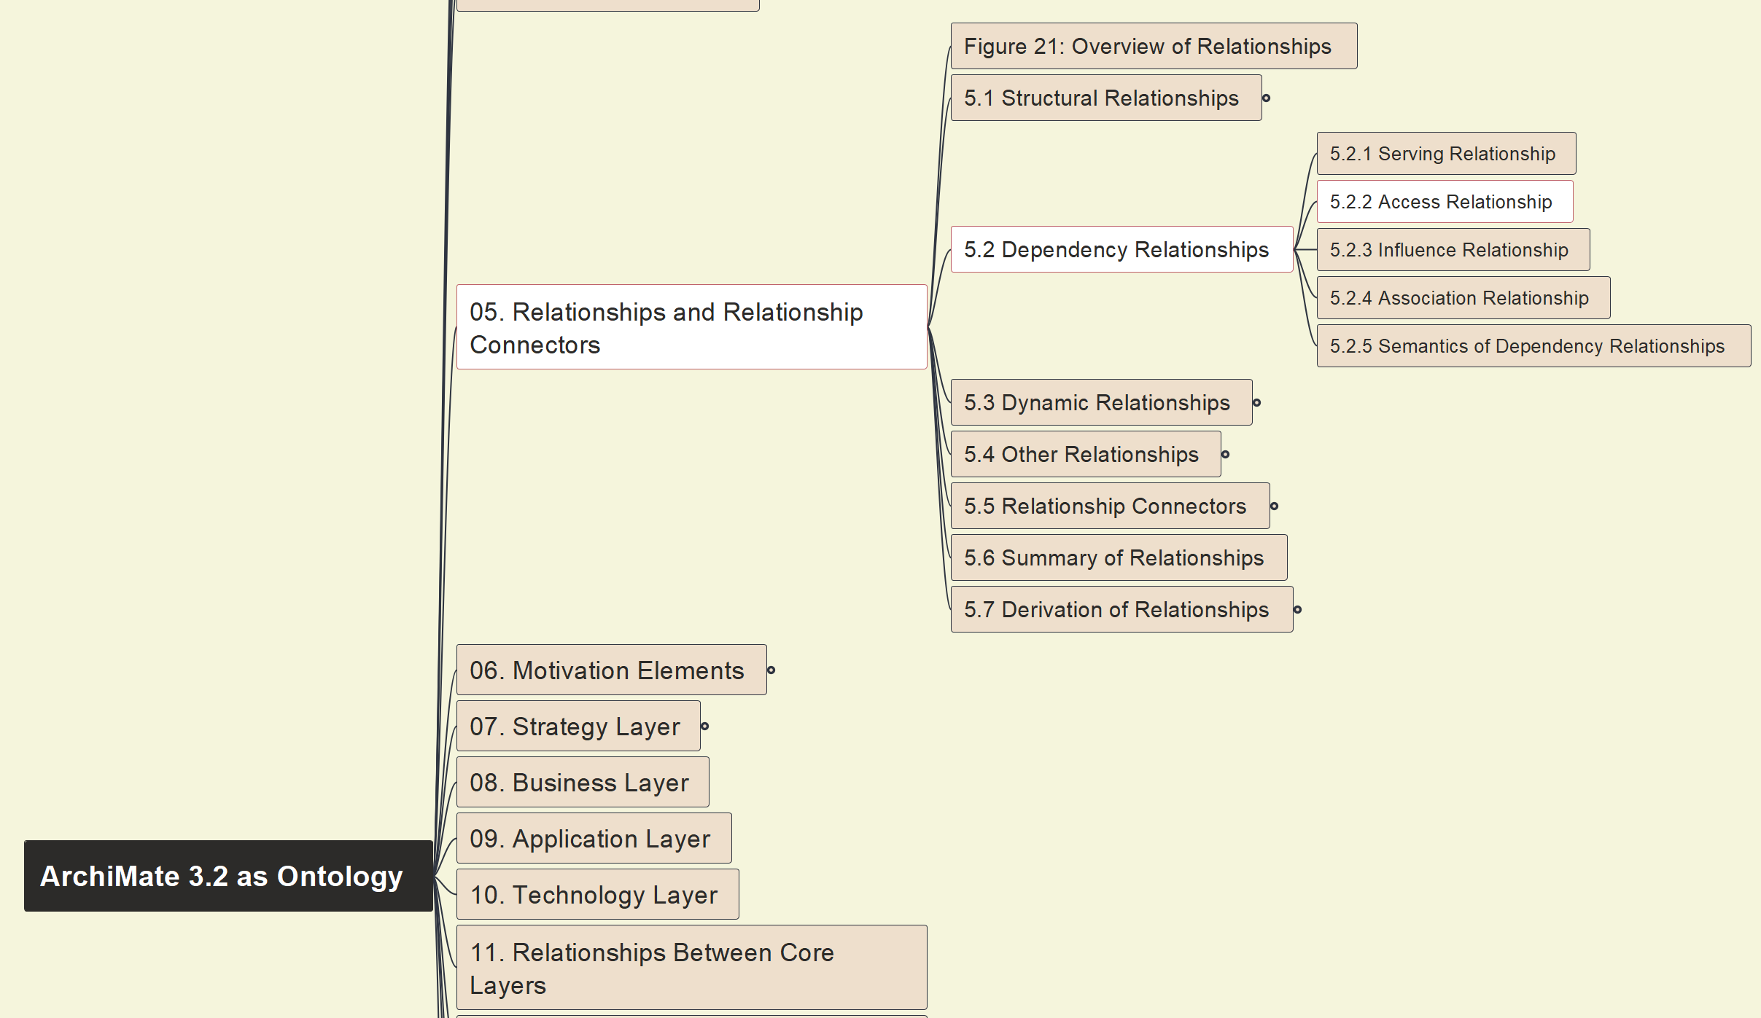
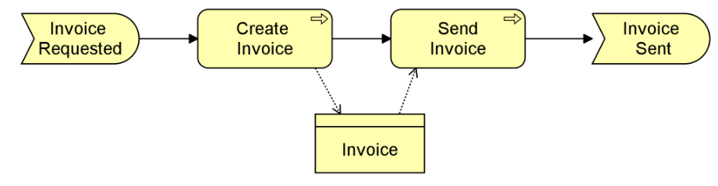
Build Ontology View on ArchiMate 3.2
030
5.2 Dependency 5.2.2 Access

Slide 31
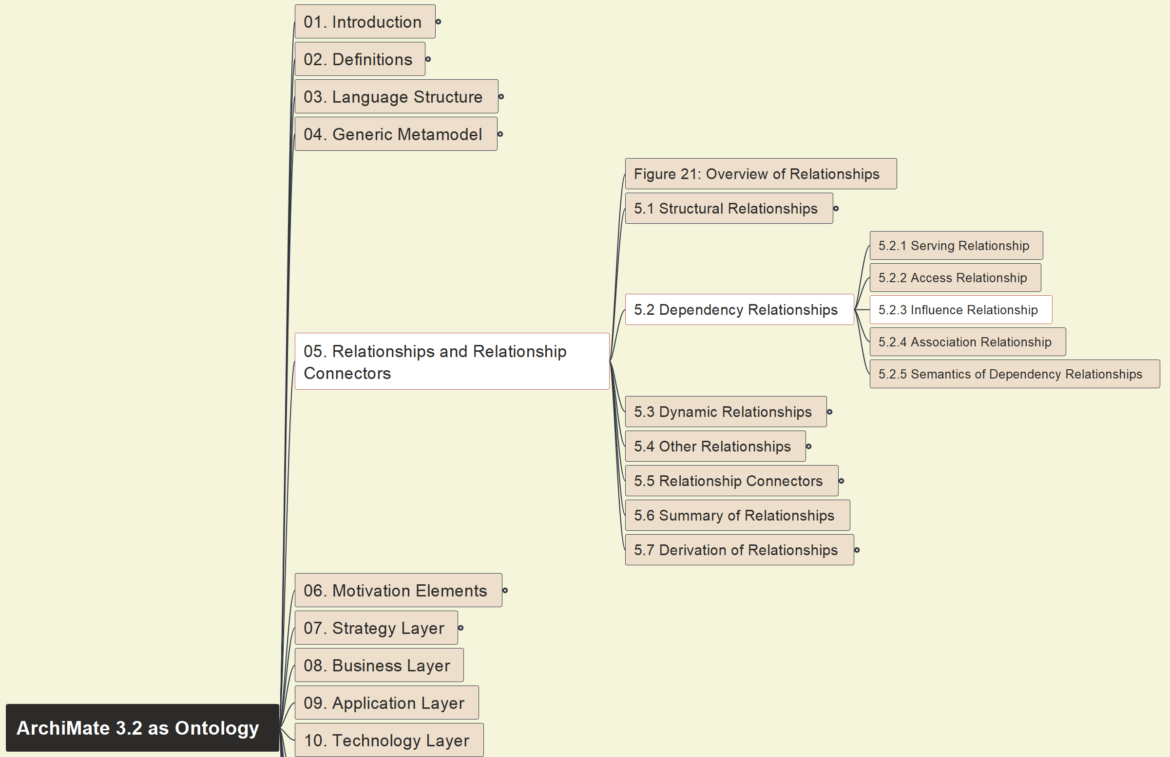

Build Ontology View on ArchiMate 3.2
031
5.2 Dependency 5.2.3 Influence

Slide 32


Build Ontology View on ArchiMate 3.2
032
5.2 Dependency 5.2.4 Association

Slide 33


Build Ontology View on ArchiMate 3.2
033
5.2 Dependency 5.2.5 Semantics View

Slide 34

Build Ontology View on ArchiMate 3.2
034
5.3 Dynamic 5.3.1 Triggering

Slide 35


Build Ontology View on ArchiMate 3.2
035
5.3 Dynamic 5.3.2 Flow Relationship

Slide 36

Build Ontology View on ArchiMate 3.2
036
5.3 Dynamic 5.3.3 Semantics View

Slide 37


Build Ontology View on ArchiMate 3.2
037
5.4 Other Relations

Slide 38


Build Ontology View on ArchiMate 3.2
038
5.5 Relationship Connectors

Slide 39

Build Ontology View on ArchiMate 3.2
039
5.6 Summary of Relationships

Slide 40



Build Ontology View on ArchiMate 3.2
040
5.7 Derivation of Relationships

Slide 41


Build Ontology View on ArchiMate 3.2
041
6. Motivation Elements 6.1 Metamodel

Slide 42


Build Ontology View on ArchiMate 3.2
042
6.2 Stakeholder, Driver, and Assessment

Slide 43


Build Ontology View on ArchiMate 3.2
043
6.2.4 Example 18

Slide 44

Build Ontology View on ArchiMate 3.2
044
6.3 – 6.3.1 Goal, 6.3.2 Outcome

Slide 45

Build Ontology View on ArchiMate 3.2
045
6.3.3 – 6.3.5 Principle, Req. and Constraint

Slide 46


Build Ontology View on ArchiMate 3.2
046
6.3 Example 19

Slide 47

Build Ontology View on ArchiMate 3.2
047
6.4 – 6.4.1 Meaning, 6.4.2 Value

Slide 48


Build Ontology View on ArchiMate 3.2
048
6.4 Meaning & Value 6.4.3 Example 20

Slide 49


Build Ontology View on ArchiMate 3.2
049
6.5 Summary of Motivation 6.6 Rel. w/ Core

Slide 50


Build Ontology View on ArchiMate 3.2
050
7. Strategy Layer – 7.1 Metamodel

Slide 51

Build Ontology View on ArchiMate 3.2
051
7.2.1 Resource, 7.3.1 Capability

Slide 52

Build Ontology View on ArchiMate 3.2
052
7.3.2 Value Stream, 7.3.3 Course of Action

Slide 53


Build Ontology View on ArchiMate 3.2
053
7.4 Example 21 on Capability, Resource and Course of Action

Slide 54


Build Ontology View on ArchiMate 3.2
054
7.4 Example 22 on Value Stream with Capability Cross-Mapping

Slide 55


Build Ontology View on ArchiMate 3.2
055
7.5 Summary of Strategy Element, 7.6 Relationships with Motivation & Core Elements

Slide 56


Build Ontology View on ArchiMate 3.2
056
8.1 Business Layer Metamodel

Slide 57

Build Ontology View on ArchiMate 3.2
057
8.2 Active Structure Elements

Slide 58


Build Ontology View on ArchiMate 3.2
058
8.2 Active Structure Elements – Example 23

Slide 59


Build Ontology View on ArchiMate 3.2
059
8.3 Behavior Elements – 8.3.1, 8.3.2

Slide 60


Build Ontology View on ArchiMate 3.2
060
8.3 Behavior Elements – 8.3.3, 8.3.4, 8.3.5

Slide 61


Build Ontology View on ArchiMate 3.2
061
8.3 Behavior Elements – 8.3.6 Example 24

Slide 62


Build Ontology View on ArchiMate 3.2
062
8.4 Passive Structure Elements

Slide 63


Build Ontology View on ArchiMate 3.2
063
8.4.4 Passive Structure Elements – Example

Slide 64


Build Ontology View on ArchiMate 3.2
064
8.5 Composite Elements – 8.5.1 Product

Slide 65


Build Ontology View on ArchiMate 3.2
065
8.5 Composite Elements – 8.5.2 Example 26

Slide 66


Build Ontology View on ArchiMate 3.2
066
09 Application Layer – 9.1 Application Layer Metamodel

Slide 67


Build Ontology View on ArchiMate 3.2
067
09 Application Layer – 9.2 Active Structure Elements

Slide 68


Build Ontology View on ArchiMate 3.2
068
09 Application Layer – 9.2 Active Structure Elements - Example

Slide 69


Build Ontology View on ArchiMate 3.2
069
09 Application Layer – 9.3.1~9.3.3 Application Function, Interaction, Process

Slide 70


Build Ontology View on ArchiMate 3.2
070
09 Application Layer – 9.3.4 Application Event, 9.3.5 Application Service

Slide 71


Build Ontology View on ArchiMate 3.2
071
09 Application Layer – 9.3.6 Example

Slide 72


Build Ontology View on ArchiMate 3.2
072
09 Application Layer – 9.4.1 Data Object

Slide 73


Build Ontology View on ArchiMate 3.2
073
09 Application Layer – 9.4.2 Example, 9.5 Summary

Slide 74


Build Ontology View on ArchiMate 3.2
074
10 Technology Layer – 10.1 Metamodel

Slide 75



Build Ontology View on ArchiMate 3.2
075
10 Technology Layer – 10.2 Active Structure Elements – Overview & 10.2.1 Node

Slide 76



Build Ontology View on ArchiMate 3.2
076
10 Technology Layer – 10.2 Active Structure Elements –10.2.2 Device & 10.2.3 System Software

Slide 77



Build Ontology View on ArchiMate 3.2
077
10 Technology Layer – 10.2 Active Structure Elements –10.2.4 & 10.2.5 Technology Collaboration & Interface

Slide 78



Build Ontology View on ArchiMate 3.2
078
10 Technology Layer – 10.2 Active Structure Elements –10.2.6 Path & 10.2.7 Communication Network

Slide 79


Build Ontology View on ArchiMate 3.2
079
10 Technology Layer – 10.2 Active Structure Elements –10.2.8 Example(30)

Slide 80



Build Ontology View on ArchiMate 3.2
080
10 Technology Layer – 10.3 Behavior Elements – 10.3.1 & 10.3.2 Technology Function & Process

Slide 81




Build Ontology View on ArchiMate 3.2
081
10 Technology Layer – 10.3 Behavior Elements – 10.3.3~10.3.5 Technology Interaction & Event & Service

Slide 82


Build Ontology View on ArchiMate 3.2
082
10 Technology Layer – 10.3 Behavior Elements – 10.3.6 Example(31)

Slide 83


Build Ontology View on ArchiMate 3.2
083
10 Technology Layer – 10.4 Passive Structure Elements – 10.4.1 Artifact

Slide 84


Build Ontology View on ArchiMate 3.2
084
10 Technology Layer – 10.4 Passive Structure Elements – 10.4.2 Example(32)

Slide 85


Build Ontology View on ArchiMate 3.2
085
10 Technology Layer – 10.5 Physical Elements Meta-Model

Slide 86


Build Ontology View on ArchiMate 3.2
086
10 Technology Layer – 10.6 Physical Active Structure Elements

Slide 87


Build Ontology View on ArchiMate 3.2
087
10 Technology Layer – 10.7 Physical Passive Structure Elements

Slide 88


Build Ontology View on ArchiMate 3.2
088
10 Technology Layer – 10.8 Example & 10.9 Summary

Slide 89


Build Ontology View on ArchiMate 3.2
089
11.1 Alignment of the Business Layer and Lower Layers

Slide 90


Build Ontology View on ArchiMate 3.2
090
11.2 Alignment of the Application Layer and Technology Layers

Slide 91


Build Ontology View on ArchiMate 3.2
091
11. Relationships between Core Layers
11.3 Example

Slide 92


Build Ontology View on ArchiMate 3.2
092
12. Implementation and Migration Layer
12.1 Elements Metamodel

Slide 93


Build Ontology View on ArchiMate 3.2
093
12. Implementation and Migration Layer
12.2 Elements Ontology Setup

Slide 94


Build Ontology View on ArchiMate 3.2
094
12. Implementation and Migration Layer
12.2.6 Example

Slide 95


Build Ontology View on ArchiMate 3.2
095
12. Implementation and Migration Layer
12.3 Summary 12.4~5 Relationships

Slide 96


Build Ontology View on ArchiMate 3.2
096
13 Stakeholders, Archi Views/Viewpoints
13.1 Introduction 13.2 Stakeholders & Concerns

Slide 97


Build Ontology View on ArchiMate 3.2
097
13 Stakeholders, Archi Views/Viewpoints
13.3~5 Architecture Views & Viewpoints

Slide 98


Build Ontology View on ArchiMate 3.2
098
14 Language Customization Mechanisms
14.1 Adding Attributes to ArchiMate Concepts

Slide 99


Build Ontology View on ArchiMate 3.2
099
14 Language Customization Mechanisms
14.2 Concepts Specialization – 14.2.1

Slide 100


Build Ontology View on ArchiMate 3.2
100
14 Language Customization Mechanisms
14.2 Concepts Specialization – 14.2.2

Slide 101


Build Ontology View on ArchiMate 3.2
101
14 Language Customization Mechanisms
14.2 Concepts Specialization – 14.2.3

Slide 102


Build Ontology View on ArchiMate 3.2
102
14 Language Customization Mechanisms
14.2 Concepts Specialization – 14.2.4

Slide 103


Build Ontology View on ArchiMate 3.2
103
14 Language Customization Mechanisms
14.2 Concepts Specialization – 14.2.5

Slide 104

Build Ontology View on ArchiMate 3.2
104
14 Language Customization Mechanisms
14.2 Concepts Specialization – 14.2.5 Example

Slide 105



Build Ontology View on ArchiMate 3.2
105
14 Language Customization Mechanisms
14.2 Concepts Specialization – 14.2.6 & 14.2.7

Slide 106



Build Ontology View on ArchiMate 3.2
106
14 Language Customization Mechanisms
14.2 Concepts Specialization – 14.2.8 & 14.2.9

Slide 107

Build Ontology View on ArchiMate 3.2
107
Appendix B: Relationships (Normative)
B.1 Specification of Derivation Rules

Slide 108


Build Ontology View on ArchiMate 3.2
108
Appendix B: Relationships (Normative)
B.2 Derivation Rules - B.2.1 Specialization

Slide 109


Build Ontology View on ArchiMate 3.2
109
Appendix B: Relationships (Normative)
B.2 Derivation Rules - B.2.2 Structural

Slide 110

Build Ontology View on ArchiMate 3.2
110
Appendix B: Relationships (Normative)
B.2 Derivation Rules - B.2.2 Structural - Example

Slide 111


Build Ontology View on ArchiMate 3.2
111
Appendix B: Relationships (Normative)
B.2 Derivation Rules - B.2.3 Dependency

Slide 112


Build Ontology View on ArchiMate 3.2
112
Appendix B: Relationships (Normative)
B.2 Derivation Rules - B.2.4 Dynamic (1)

Slide 113

Build Ontology View on ArchiMate 3.2
113
Appendix B: Relationships (Normative)
B.2 Derivation Rules - B.2.4 Dynamic – (1) Example

Slide 114

Build Ontology View on ArchiMate 3.2
114
Appendix B: Relationships (Normative)
B.2 Derivation Rules - B.2.4 Dynamic (2)

Slide 115

Build Ontology View on ArchiMate 3.2
115
Appendix B: Relationships (Normative)
B.2 Derivation Rules - B.2.4 Dynamic – (2) Example

Slide 116


Build Ontology View on ArchiMate 3.2
116
Appendix B: Relationships (Normative)
B.3 Derivation Rules for Potential Relationships

Slide 117


Build Ontology View on ArchiMate 3.2
117
Appendix B: Relationships (Normative)
B.3.1 Potential Derivation for Specialization

Slide 118

Build Ontology View on ArchiMate 3.2
118
Appendix B: Relationships (Normative)
B.3.1 Potential Derivation for Specialization - Example

Slide 119


Build Ontology View on ArchiMate 3.2
119
Appendix B: Relationships (Normative)
B.3.2 Potential Derivation for Structural and Dependency

Slide 120


Build Ontology View on ArchiMate 3.2
120
Appendix B: Relationships (Normative)
B.3.3 Potential Derivation for Dependency Relationships

Slide 121


Build Ontology View on ArchiMate 3.2
121
Appendix B: Relationships (Normative)
B.3.4 Potential Derivation for Dynamic Relationships (1)

Slide 122

Build Ontology View on ArchiMate 3.2
122
Appendix B: Relationships (Normative)
B.3.4 Potential Derivation for Dynamic Relationships (2)

Slide 123


Build Ontology View on ArchiMate 3.2
123
Appendix B: Relationships (Normative)
B.3.5 Potential Derivation Rule for Grouping

Slide 124

Build Ontology View on ArchiMate 3.2
124
Appendix B: Relationships (Normative)
B.4 ~ B.6: Relationships Summary

Slide 125


Build Ontology View on ArchiMate 3.2
125
Appendix C: Example Viewpoints
Opening and Introduction & C.1 Overview

Slide 126
Build Ontology View on ArchiMate 3.2
126
Appendix C: Example Viewpoints
C.1 Basic Viewpoints in the ArchiMate Language

Slide 127


Build Ontology View on ArchiMate 3.2
127
Appendix C: Example Viewpoints
C.1.1 Organization Viewpoint

Slide 128

Build Ontology View on ArchiMate 3.2
128
Appendix C: Example Viewpoints
C.1.1 Organization Viewpoint - Sample

Slide 129


Build Ontology View on ArchiMate 3.2
129
Appendix C: Example Viewpoints
C.1.2 Application Structure Viewpoint

Slide 130

Build Ontology View on ArchiMate 3.2
130
Appendix C: Example Viewpoints
C.1.2 Application Structure Viewpoint - Sample

Slide 131


Build Ontology View on ArchiMate 3.2
131
Appendix C: Example Viewpoints
C.1.3 Information Structure Viewpoint

Slide 132

Build Ontology View on ArchiMate 3.2
132
Appendix C: Example Viewpoints
C.1.3 Information Structure Viewpoint – Sample - 1

Slide 133

Build Ontology View on ArchiMate 3.2
133
Appendix C: Example Viewpoints
C.1.3 Information Structure Viewpoint – Sample - 2

Slide 134


Build Ontology View on ArchiMate 3.2
134
Appendix C: Example Viewpoints
C.1.4 Technology Viewpoint

Slide 135

Build Ontology View on ArchiMate 3.2
135
Appendix C: Example Viewpoints
C.1.4 Technology Viewpoint – Sample - 1

Slide 136

Build Ontology View on ArchiMate 3.2
136
Appendix C: Example Viewpoints
C.1.4 Technology Viewpoint – Sample - 2

Slide 137


Build Ontology View on ArchiMate 3.2
137
Appendix C: Example Viewpoints
C.1.5 Layered Viewpoint

Slide 138


Build Ontology View on ArchiMate 3.2
138
Appendix C: Example Viewpoints
C.1.5 Layered Viewpoint – Example 1

Slide 139


Build Ontology View on ArchiMate 3.2
139
Appendix C: Example Viewpoints
C.1.5 Layered Viewpoint – Example 2

Slide 140


Build Ontology View on ArchiMate 3.2
140
Appendix C: Example Viewpoints
C.1.6 Physical Viewpoint

Slide 141


Build Ontology View on ArchiMate 3.2
141
Appendix C: Example Viewpoints
C.1.6 Physical Viewpoint – Example 1

Slide 142


Build Ontology View on ArchiMate 3.2
142
Appendix C: Example Viewpoints
C.1.6 Physical Viewpoint – Example 2

Slide 143


Build Ontology View on ArchiMate 3.2
143
Appendix C: Example Viewpoints
C.1.7 Product Viewpoint

Slide 144


Build Ontology View on ArchiMate 3.2
144
Appendix C: Example Viewpoints
C.1.7 Product Viewpoint – Example 1

Slide 145


Build Ontology View on ArchiMate 3.2
145
Appendix C: Example Viewpoints
C.1.7 Product Viewpoint – Example 2

Slide 146


Build Ontology View on ArchiMate 3.2
146
Appendix C: Example Viewpoints
C.1.8 Application Usage Viewpoint

Slide 147


Build Ontology View on ArchiMate 3.2
147
Appendix C: Example Viewpoints
C.1.8 Application Usage Viewpoint – Example 1

Slide 148


Build Ontology View on ArchiMate 3.2
148
Appendix C: Example Viewpoints
C.1.8 Application Usage Viewpoint – Example 2

Slide 149


Build Ontology View on ArchiMate 3.2
149
Appendix C: Example Viewpoints
C.1.9 Technology Usage Viewpoint

Slide 150


Build Ontology View on ArchiMate 3.2
150
Appendix C: Example Viewpoints
C.1.9 Technology Usage Viewpoint – Example 1

Slide 151


Build Ontology View on ArchiMate 3.2
151
Appendix C: Example Viewpoints
C.1.9 Technology Usage Viewpoint – Example 2

Slide 152


Build Ontology View on ArchiMate 3.2
152
Appendix C: Example Viewpoints
C.1.10 Business Process Cooperation Viewpoint

Slide 153


Build Ontology View on ArchiMate 3.2
153
Appendix C: Example Viewpoints
C.1.10 Business Process Cooperation Viewpoint – Ex 1

Slide 154


Build Ontology View on ArchiMate 3.2
154
Appendix C: Example Viewpoints
C.1.10 Business Process Cooperation Viewpoint – Ex 2

Slide 155


Build Ontology View on ArchiMate 3.2
155
Appendix C: Example Viewpoints
C.1.11 Application Cooperation Viewpoint

Slide 156


Build Ontology View on ArchiMate 3.2
156
Appendix C: Example Viewpoints
C.1.11 Application Cooperation Viewpoint – Ex 1

Slide 157


Build Ontology View on ArchiMate 3.2
157
Appendix C: Example Viewpoints
C.1.11 Application Cooperation Viewpoint – Ex 2

Slide 158


Build Ontology View on ArchiMate 3.2
158
Appendix C: Example Viewpoints
C.1.12 Service Realization Viewpoint

Slide 159


Build Ontology View on ArchiMate 3.2
159
Appendix C: Example Viewpoints
C.1.12 Service Realization Viewpoint – Example 1

Slide 160


Build Ontology View on ArchiMate 3.2
160
Appendix C: Example Viewpoints
C.1.12 Service Realization Viewpoint – Example 2

Slide 161


Build Ontology View on ArchiMate 3.2
161
Appendix C: Example Viewpoints
C.1.13 Implementation and Deployment Viewpoint

Slide 162


Build Ontology View on ArchiMate 3.2
162
Appendix C: Example Viewpoints
C.1.13 Implementation and Deployment Viewpoint – Ex 1

Slide 163


Build Ontology View on ArchiMate 3.2
163
Appendix C: Example Viewpoints
C.1.13 Implementation and Deployment Viewpoint – Ex 2

Slide 164


Build Ontology View on ArchiMate 3.2
164
Appendix C: Example Viewpoints
C.2.1 Motivation – Stakeholder Viewpoint

Slide 165


Build Ontology View on ArchiMate 3.2
165
Appendix C: Example Viewpoints
C.2.1 Motivation – Stakeholder Viewpoint – Example 1

Slide 166


Build Ontology View on ArchiMate 3.2
166
Appendix C: Example Viewpoints
C.2.1 Motivation – Stakeholder Viewpoint – Example 2

Slide 167


Build Ontology View on ArchiMate 3.2
167
Appendix C: Example Viewpoints
C.2.2 Motivation – Goal Realization Viewpoint

Slide 168


Build Ontology View on ArchiMate 3.2
168
Appendix C: Example Viewpoints
C.2.2 Motivation – Goal Realization Viewpoint – Example 1

Slide 169


Build Ontology View on ArchiMate 3.2
169
Appendix C: Example Viewpoints
C.2.2 Motivation – Goal Realization Viewpoint – Example 2

Slide 170

Build Ontology View on ArchiMate 3.2
170
Appendix C: Example Viewpoints
C.2.3 Motivation – Goal Contribution Viewpoint

Slide 171


Build Ontology View on ArchiMate 3.2
171
Appendix C: Example Viewpoints
C.2.3 Motivation – Goal Contribution Viewpoint – Example 1

Slide 172


Build Ontology View on ArchiMate 3.2
172
Appendix C: Example Viewpoints
C.2.3 Motivation – Goal Contribution Viewpoint – Example 2

Slide 173


Build Ontology View on ArchiMate 3.2
173
Appendix C: Example Viewpoints
C.2.3 Motivation – Goal Contribution Viewpoint – Example 2

Slide 174





